Slide 1
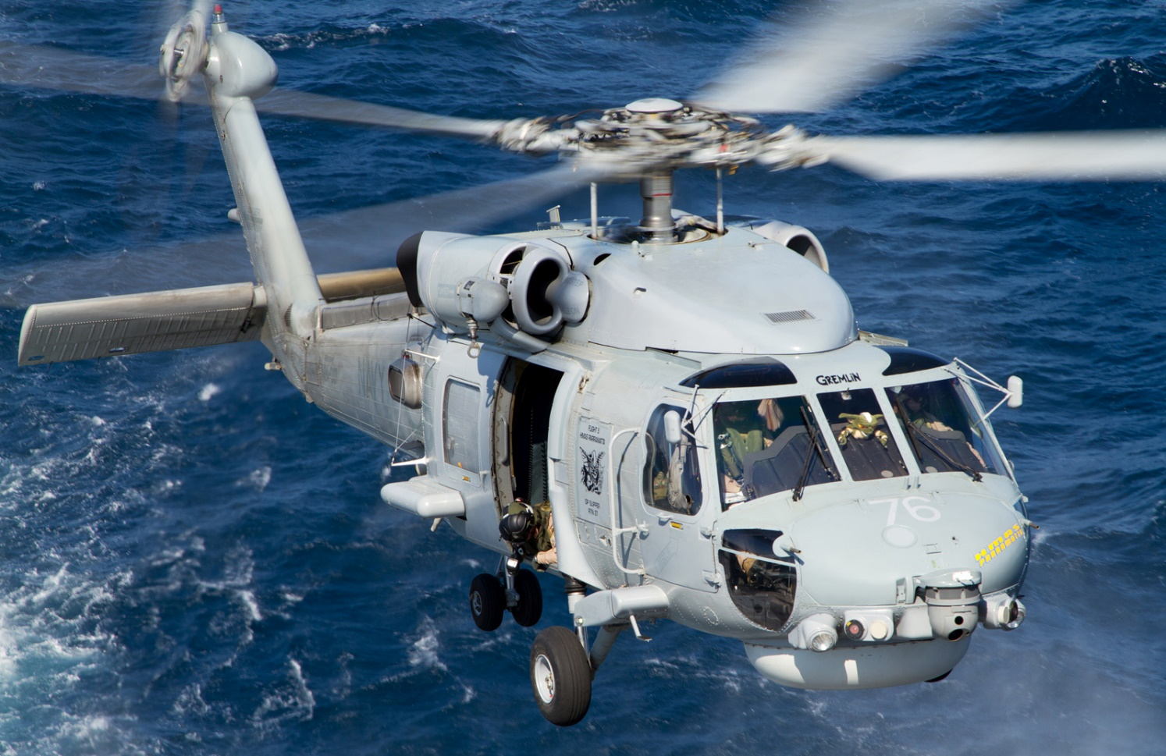
Sikorsky S-70B-2 Seahawk Presentation

Slide 2
Sikorsky S-70B-2 Seahawk
It is our pleasure to offer for sale eleven S-70B-2 Seahawk helicopters, complete with a spares / support package.
These aircraft were introduced into service between 1988 - 1992 and have an average of only 5300 hours flown since new.
The helicopters have been maintained in excellent condition by the Australian Navy. All helicopters had a mid-life upgrade providing them even more capability. They are being offered in a fully serviceable condition.
These aircraft have been mission equipped for ship based missions such as anti-surface and anti-submarine warfare, utility, transportation, and surveillance search and rescue.

Slide 3
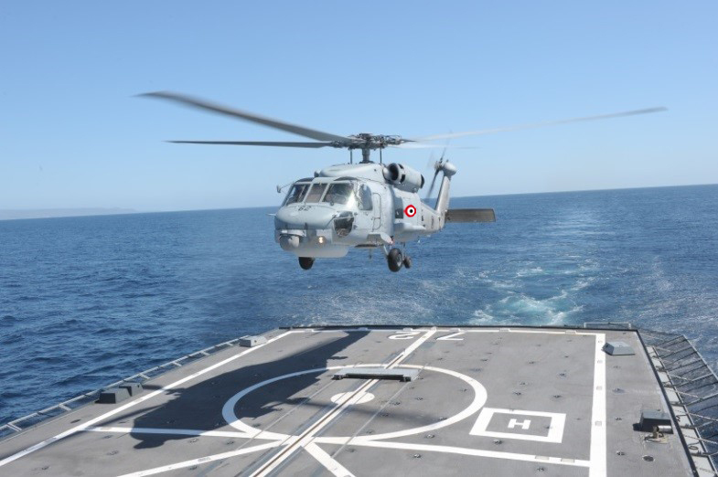
Sikorsky S-70B-2 Seahawk
One of the actual helicopters on offer.

Slide 4
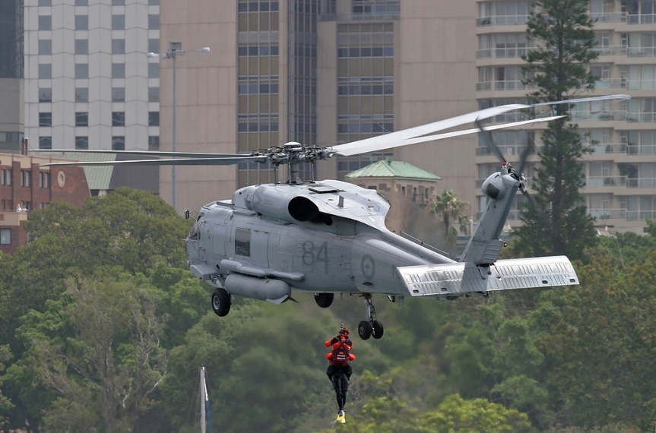
Sikorsky S-70B-2 Seahawk
The S-70B Seahawk is specifically designed for ship borne operations. They feature a strengthened gear configured for smaller spaces, a folding tail and quick fold blades.
The baseline helicopter we propose to deliver is the Seahawk with the following equipment installed:
The folding blade / tail system
Upgraded engines
Superior corrosion proofing
Cargo hook
Rescue hoist
Flotation gear
VFR/IFR avionics with auto flight system

Slide 5
Sikorsky S-70B-2 Seahawk
The S-70B / SH-60B Seahawk's general lines were very similar to those of its Army Black Hawk sibling. The external dimensions are the same, and there is 83% parts commonality between Army and Navy machines. However, there are many differences as well, some of which are hard to see. For example, the airframe is corrosion-protected and fitted with buoyancy elements for maritime operation. Other subtle changes include:
"Recovery assist secure and traverse (RAST)" or "harpoon" gear for operations off frigates and other small ocean surface vessels in rough seas.
An automatic main rotor folding system, rotor brakes, and folding stabilator and tailfin. The Seahawk stabilator is rectangular -- in contrast to the Black Hawk stabilator, which has a swept rear edge -- and folds up along each side of the tailfin. The Black Hawk does have a folding tailfin for airlift, but it has to be unbolted for folding.
Unarmored crew seats and jettison able cockpit doors.

Slide 6
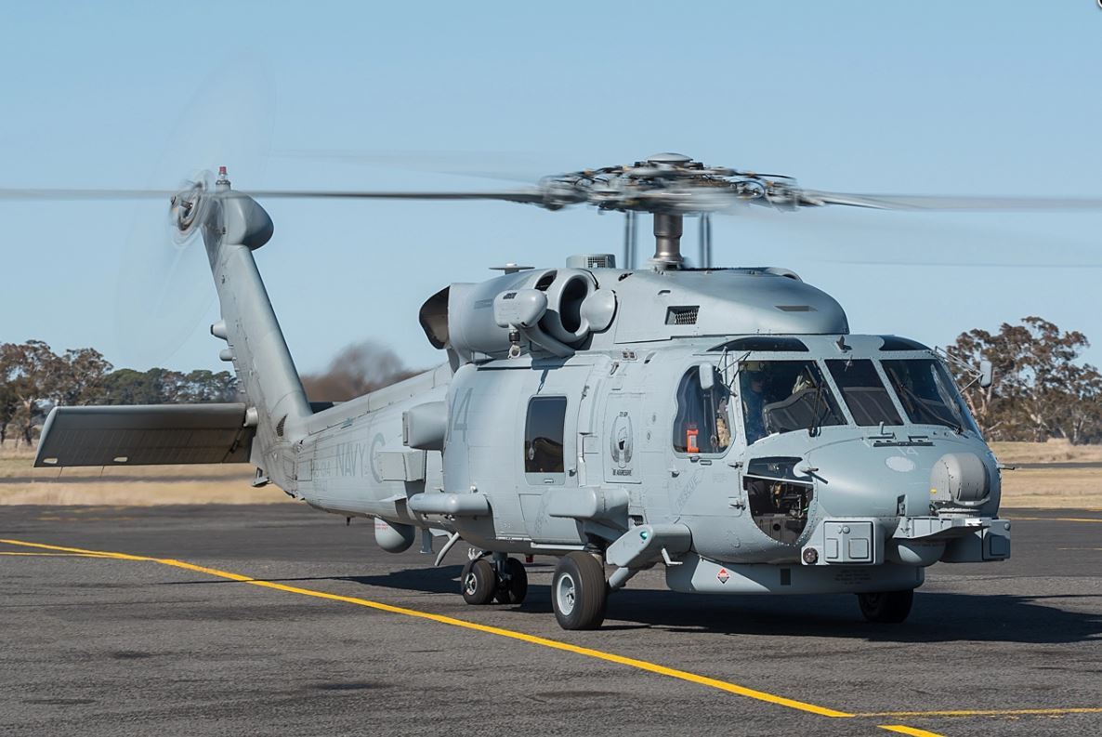
Sikorsky S-70B-2 Seahawk
An automatic flight control system (AFCS).
A considerably enhanced environmental control system to provide a temperature controlled environment for the Seahawk's avionics suite.
Hoists installed on each of the aircraft.
An emergency flotation system for ditching at sea.

Slide 7
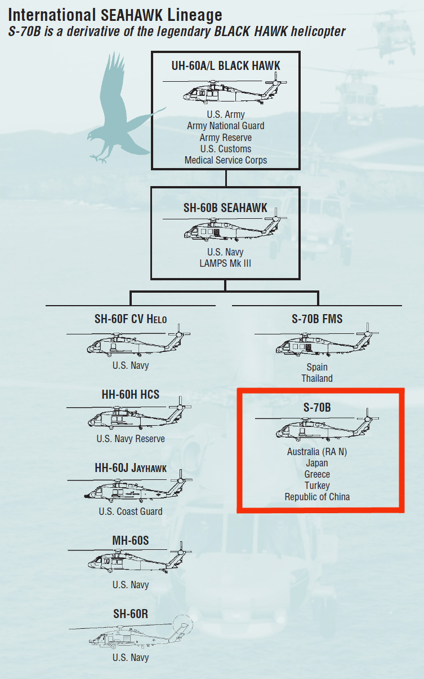
Sikorsky S-70B-2 Seahawk Presentation

Slide 8
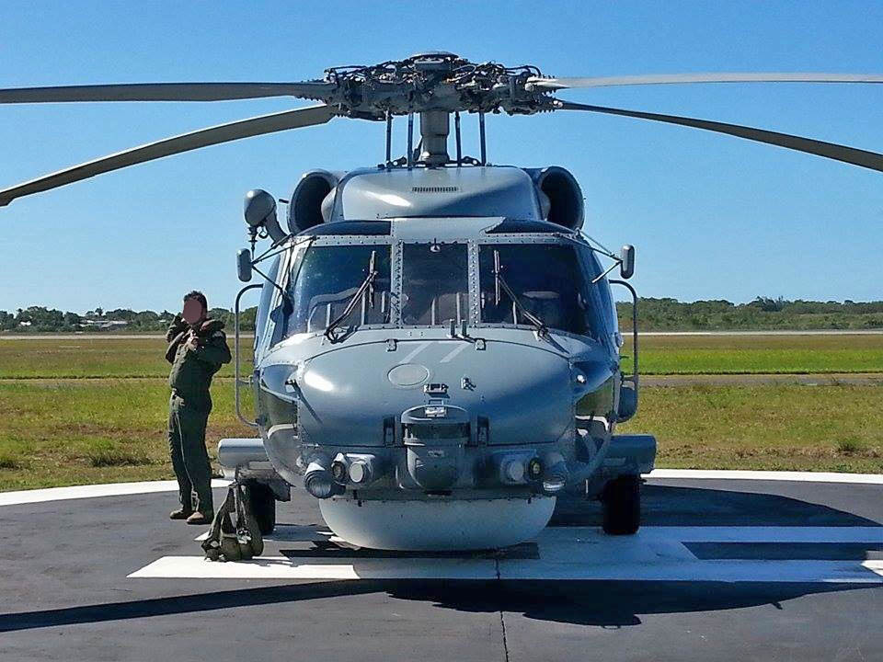
Sikorsky S-70B-2 Seahawk

Slide 9
Sikorsky S-70B-2 Seahawk
There is a stub pylon behind the cabin door on each side for carriage of a total of two Mark 46 homing torpedoes or two 455-liter (120 US gallon) external fuel tanks.
The fact that the Seahawk has a bigger kit of built-in gear makes its empty weight greater than that of the Black Hawk -- 6,190 kilograms (13,650 pounds) versus 4,820 kilograms (10,625 pounds). The Seahawk's maximum takeoff weight is also greater, at 9,925 kilograms (21,885 pounds), compared to the Black Hawk's 9,185 kilograms (20,250 pounds).
The Australian Seahawks was originally fitted with uprated T700-GE-401Cs with 1,420 kW (1,900 SHP) each, to handle the greater weight. The engines are corrosion-protected for maritime operation. The Seahawk transmission system was uprated to handle the more powerful engines. Top speed is lower due to the heavier weight and greater external clutter of the Seahawk.

Slide 10
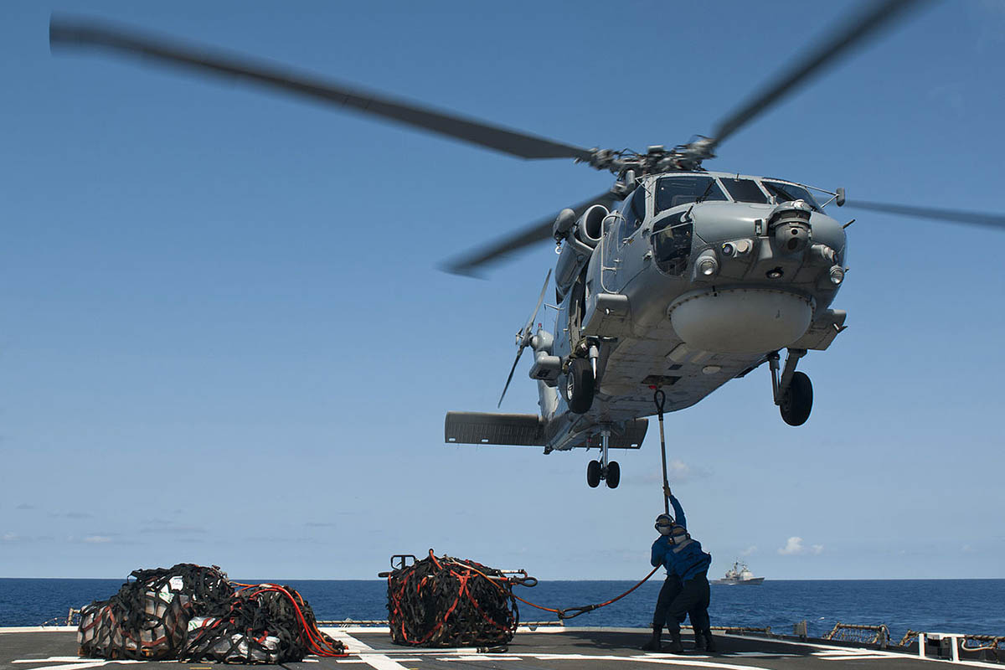
Sikorsky S-70B-2 Seahawk

Slide 11
Sikorsky S-70B-2 Seahawk
The Seahawk's landing gear is its most obvious distinguishing element. It features a two-wheel tailwheel, moved forward to the rear of the main fuselage, and taller main gear to provide clearance for the drum radome. The landing gear is simplified compared to the Black Hawk, since the heavy-duty shock absorber system of the Army version was judged unnecessary. The window and door arrangement was also substantially modified, with the door on the left eliminated and the door on the right reduced in size.
Three crew are normally carried, including a pilot, a copilot / airborne tactical officer, and sensor operator or "senso". Most of the data is transferred to the parent vessel for processing, but the crew handles the terminal attack themselves.
The Seahawk can be fitted with an external rescue hoist on the right side to support its secondary SAR role, as well as belly cargo sling hook for "vertical replenishment (vertrep)" missions.

Slide 12
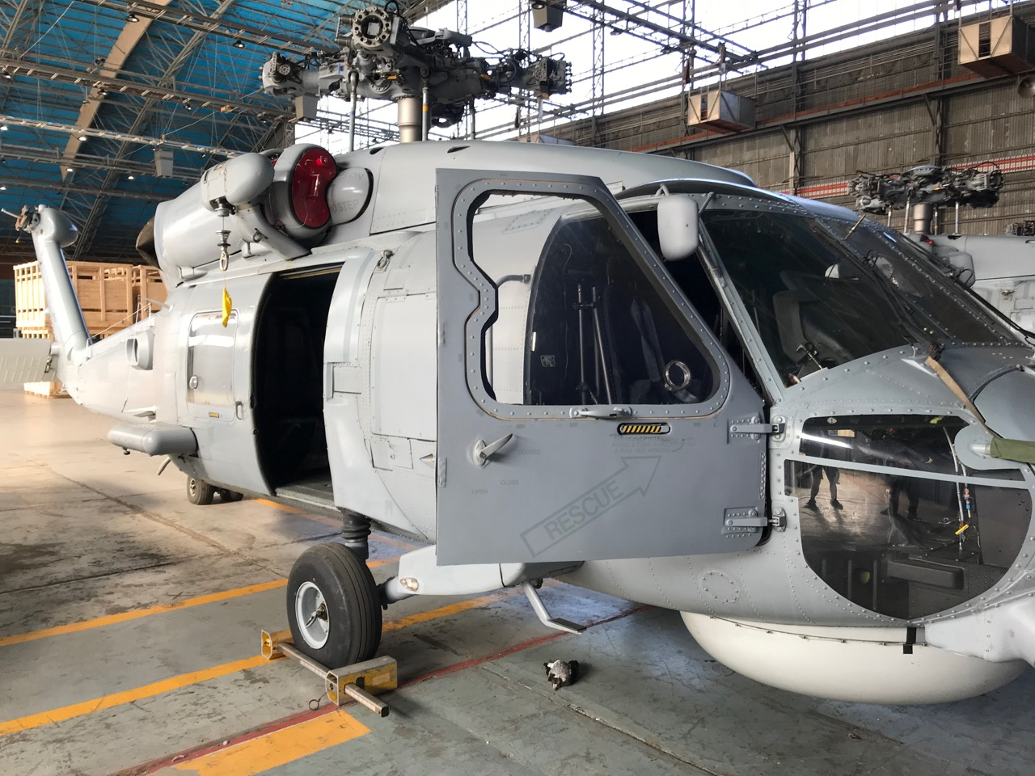
Sikorsky S-70B-2 Seahawk

Slide 13
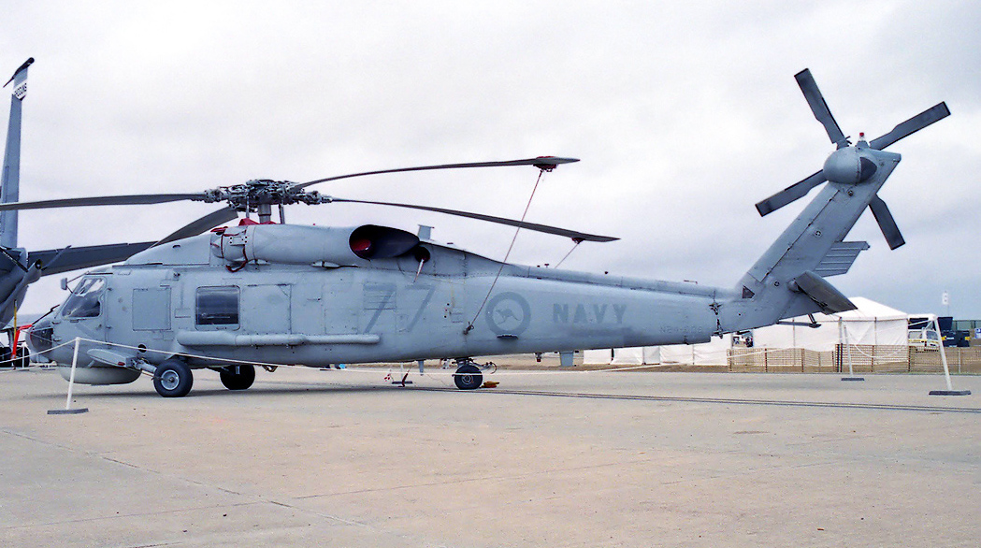
Sikorsky S-70B-2 Seahawk
We are offering ex-Australian Seahawks featuring an S-70B-2 airframe with Royal Australian Navy (RAN)-specified avionics and a rescue hoist on the starboard side.
Serial / Tail Number | A24-002 | A24-004 | A24-005 | A24-007 | A24-008 | A24-010 | A24-011 | A24-012 | A24-014 | A24-015 | A24-016
Empty Weight | 14446.5 | 14453.6 | 14431.7 | 14350.2 | 14415.1 | 14372.9 | 14499.5 | 14337.8 | 14411.8 | 14371.2 | 14438.4
Total Time Since New | 5488 | 5575.3 | 5998.8 | 4921 | 4876.2 | 4073.7 | 6471.2 | 4396.3 | 5226.6 | 4658.1 | 6108.6

Slide 14
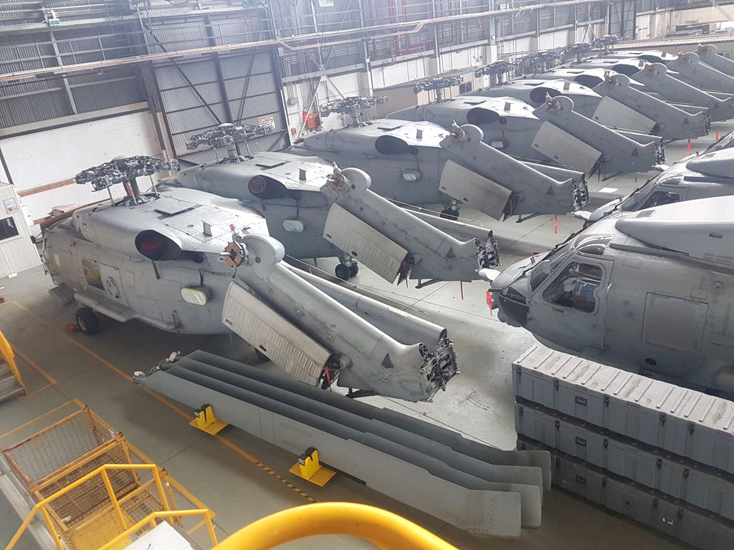
Sikorsky S-70B-2 Seahawk

Slide 15
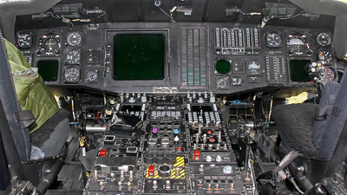
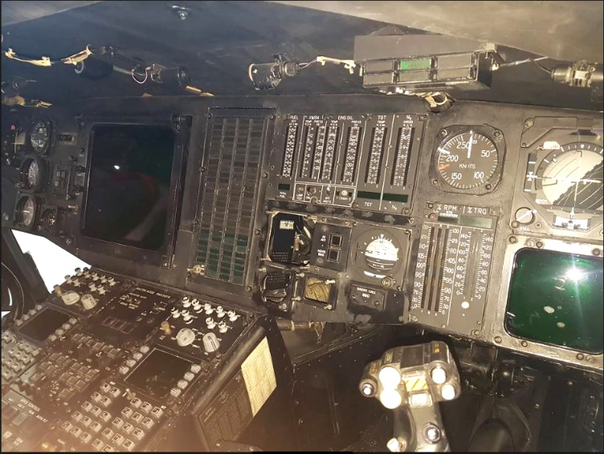
Sikorsky S-70B-2 Seahawk
AVIONICS
AFCS Systems
Attitude Heading Reference System (AHRS)
Attitude Indicators (AI)
Automatic Flight Control System (AFCS)
Horizontal Situation Video Display (HSVD)
Stabilator System
Stability Augmentation System (SAS 1)
Communication Suite
Data Handoff System Modem, DHS-901
HF Radio Set, AN/ARC-174(V)2
IFF Transponder, SIT-421T/E
Intercommunications System, ICS-
KY-58 Processor (VHF/UHF) COMSEC System
KY-100 Secure Voice Equipment
Transponder Computer, KIT-1C/TSEC
VHF/UHF Radio Set, AN/ARC-182

Slide 16
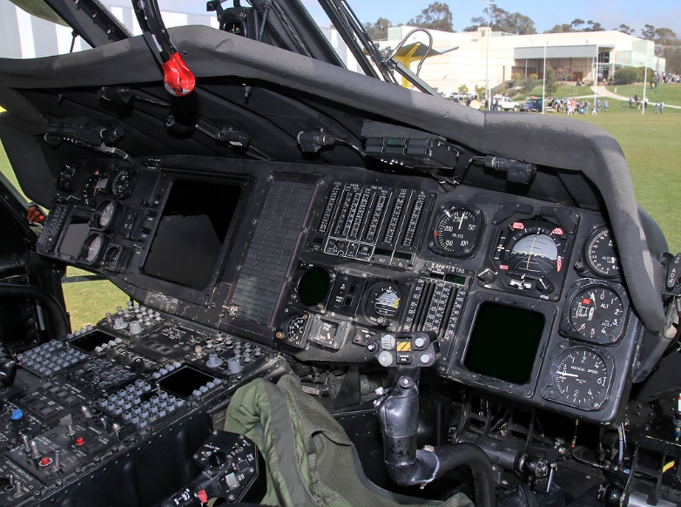
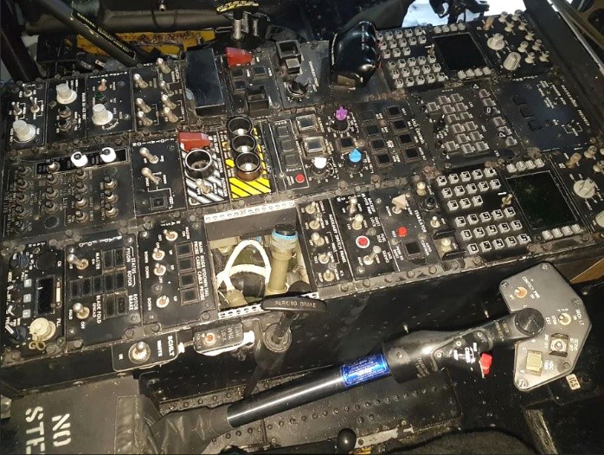
Sikorsky S-70B-2 Seahawk
Navigation Suite
Direction Finder, DF-301E
Global Positioning System
Radar Altimeter, AN/APN-194(V)
Radar Navigation Set (Doppler), AN/APN-217(V)6
Radio Navigation System, LF/ADF-60A
Super Searcher Radar
TACAN Navigational Set, AN/ARN-118
VOR/ILS/MB, VIR-130A
Tactical Data Management Suite
Bus System Interface Units (BSIU)
Data Transfer Device, DTD-
Display Generator Unit, DGU-850
Horizontal Situation Video Display (HSVD), MFD-80D
Multifunction Keyset (MFK)
Tactical Display Unit, TDU-850

Slide 17
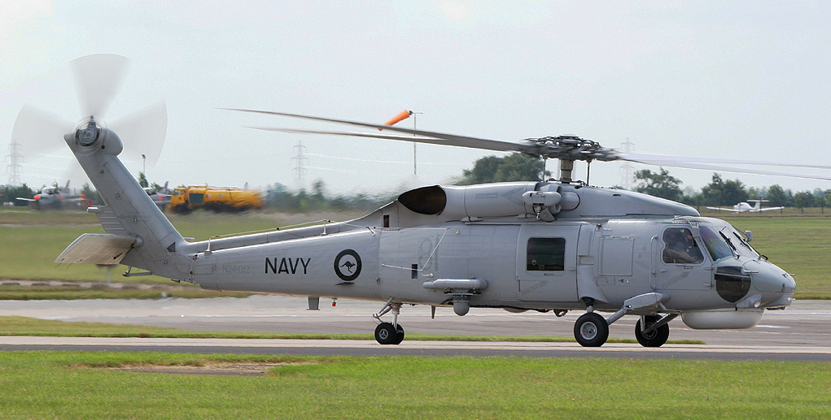
Sikorsky S-70B-2 Seahawk
Currently several of the ITAR controlled antisubmarine mission equipment has been removed as it is highly controlled.
These helicopters came out of service and were released from the Australian Navy progressively over the past 36 months. There are a total of 11 Helicopters and spare parts all currently housed at the same facility in Australia.

Slide 18
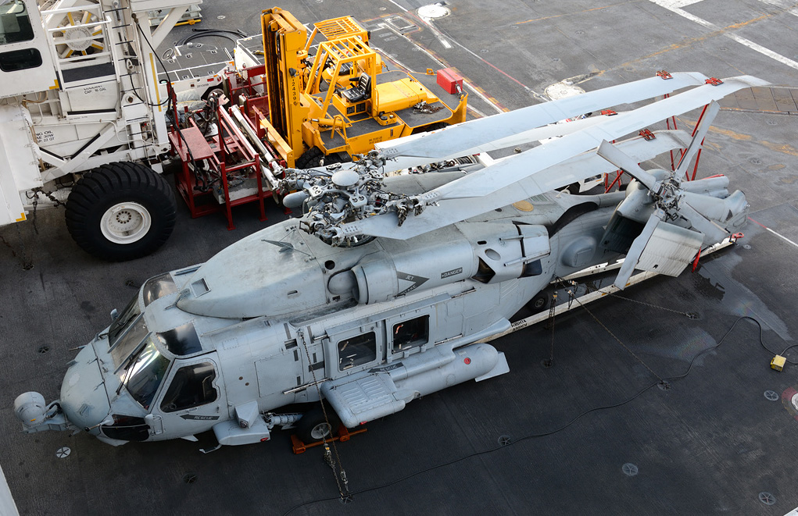
Sikorsky S-70B-2 Seahawk
Weapons Systems
Acoustic and Sonobuoy Receivers, AN/ARR-84
Forward Looking Infra-Red (FLIR) Fixed Provisions
Sonobuoy/BARRA Side
Sonobuoy Launch
.

Slide 19
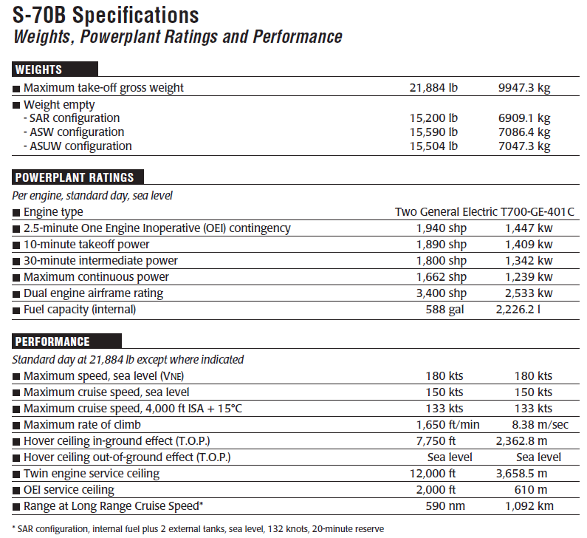
Sikorsky S-70B-2 Seahawk

Slide 20
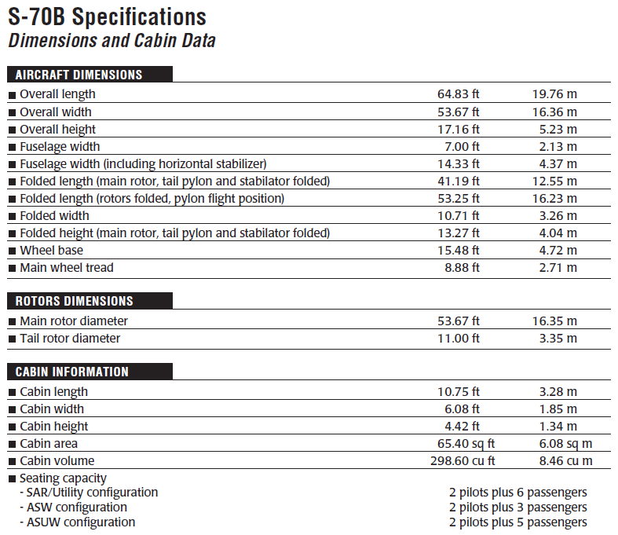
Sikorsky S-70B-2 Seahawk

Slide 21
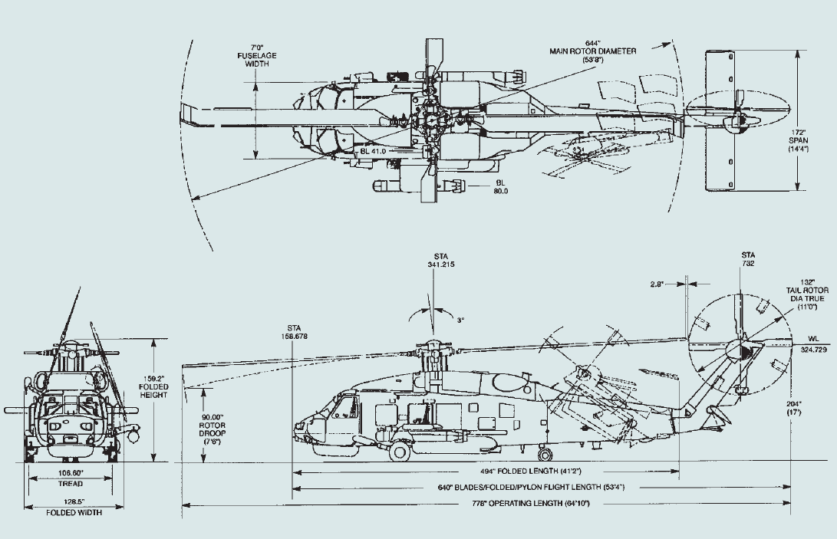
Sikorsky S-70B-2 Seahawk

Slide 22
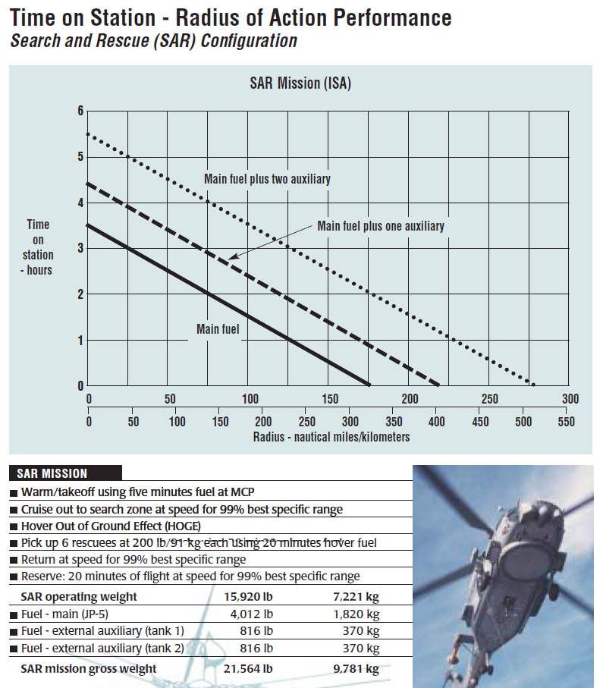
Sikorsky S-70B-2 Seahawk

Slide 23
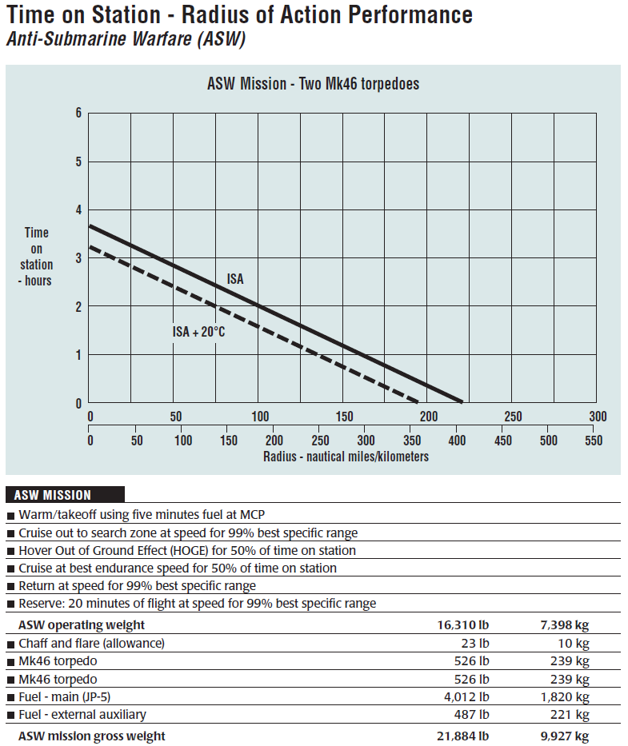
Sikorsky S-70B-2 Seahawk

Slide 24
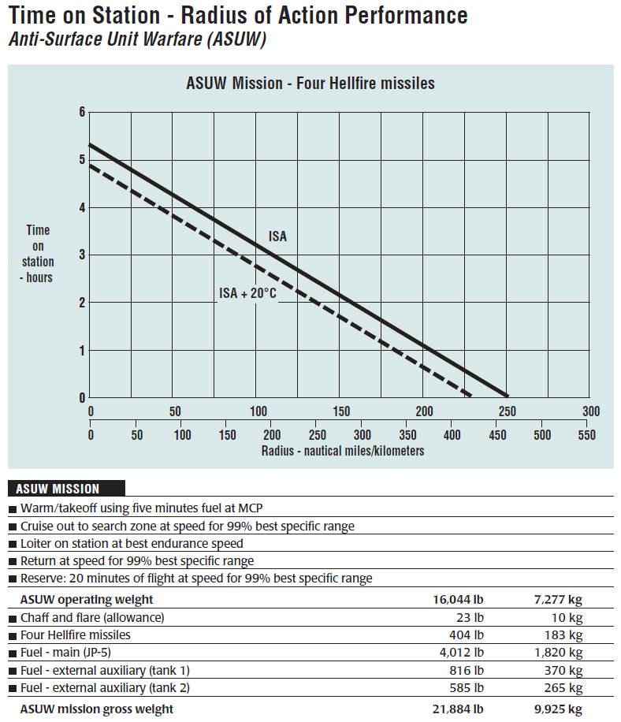
Sikorsky S-70B-2 Seahawk

Slide 25
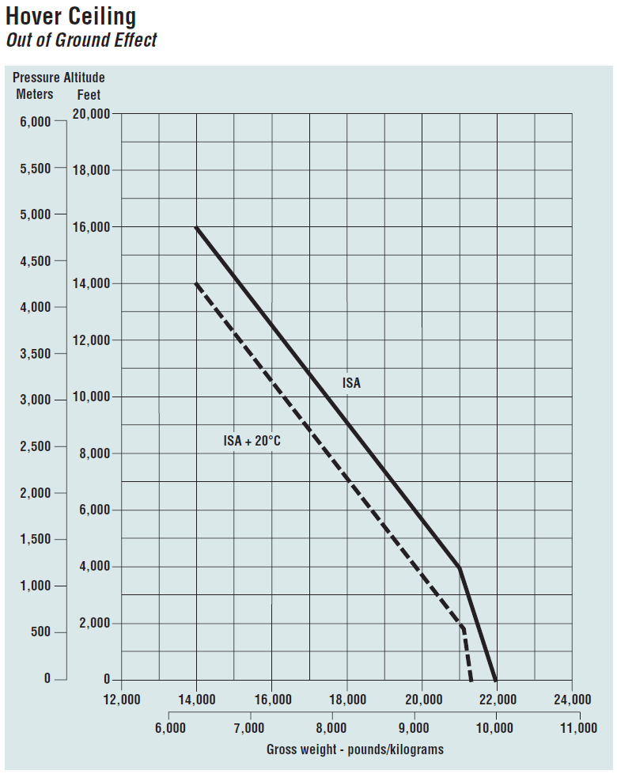
Sikorsky S-70B-2 Seahawk

Slide 26
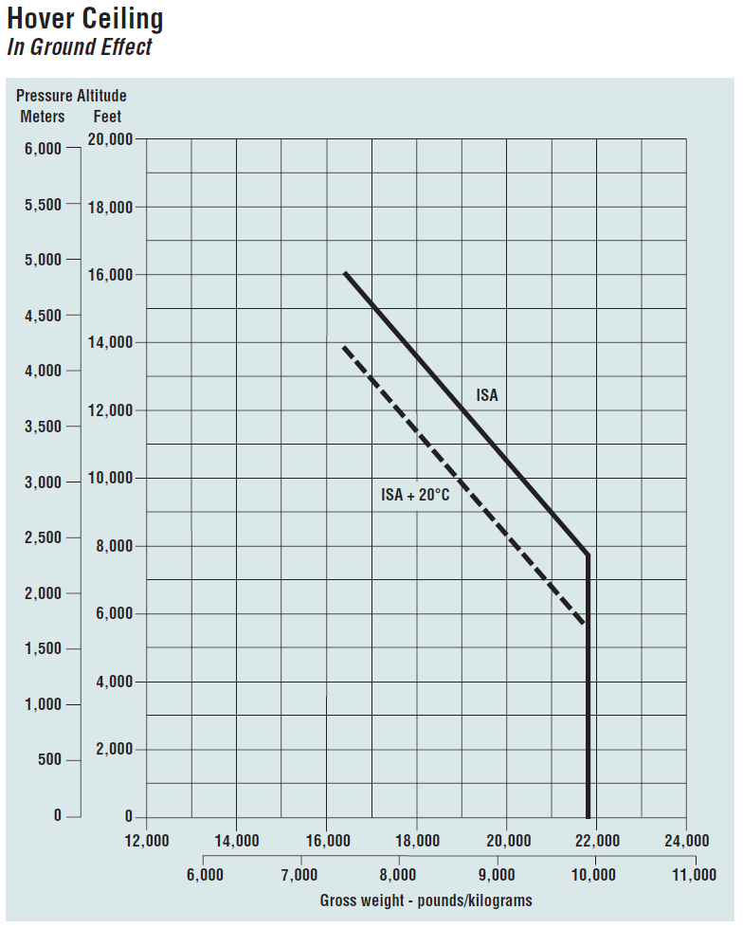
Sikorsky S-70B-2 Seahawk

Slide 27
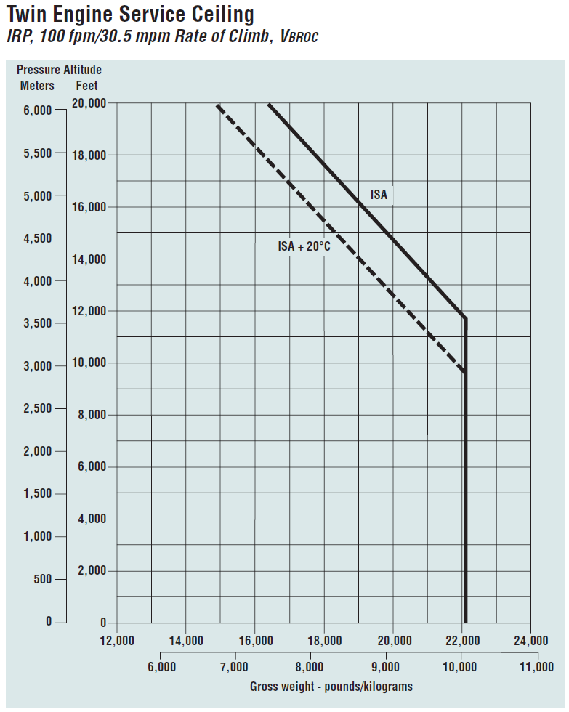
Sikorsky S-70B-2 Seahawk

Slide 28
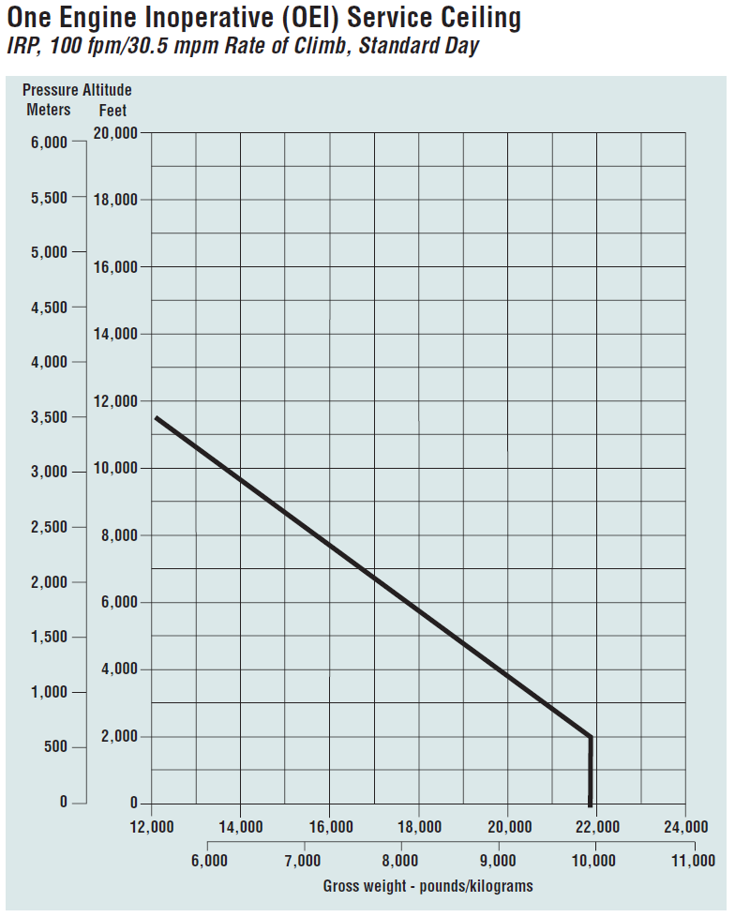
Sikorsky S-70B-2 Seahawk

Slide 29
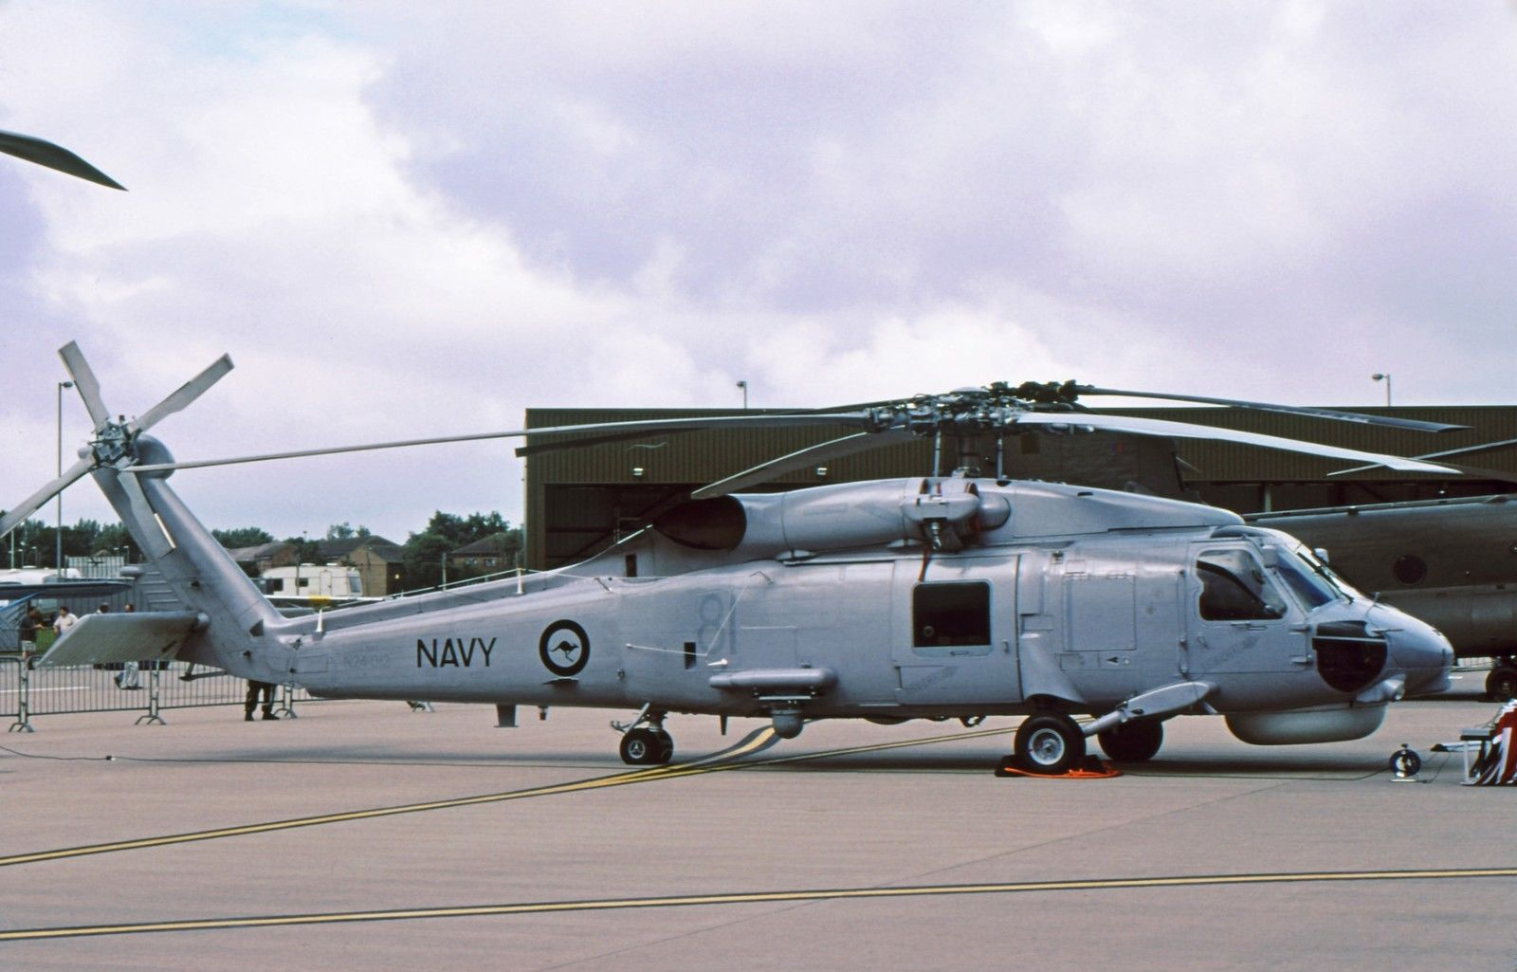
Sikorsky S-70B-2 Seahawk
A very large spares package is available and will be provided as part of the package. This spares package contains thousands of items including major components like spare engines, main rotor blades, gearboxes, and transmissions.
Any country should be able to fly these helicopters very cheaply for many years with this spares package as most items needed are included.

