Slide 1
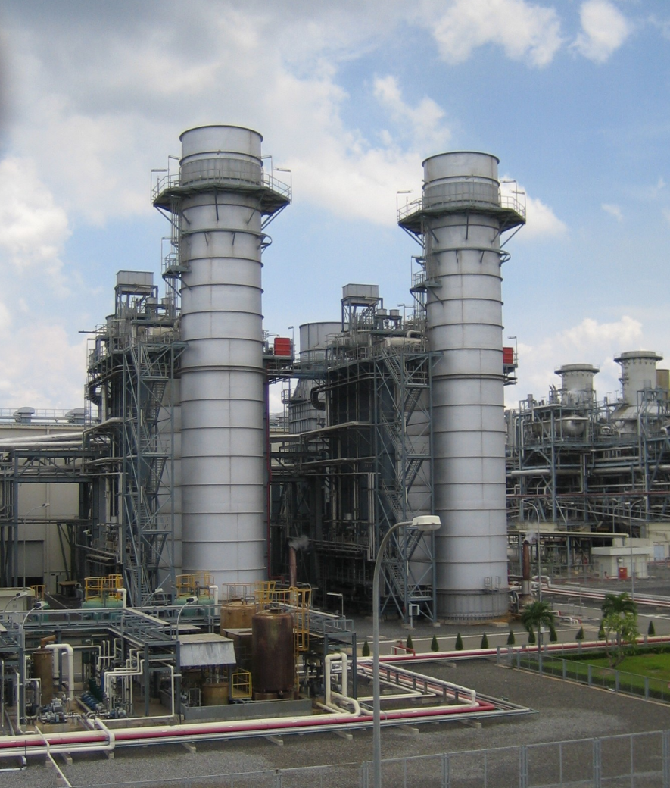
Combined Cycle Power Plant

Slide 2
Agenda
Introduction 3-5
Triple Pressure Reheat Cycle (3PRH) 6
Arrangement (Phase 1) 7
Major Equipment – Gas Turbine 8
Major Equipment – Heat recovery steam generator (HRSG) 9
Major Equipment – Steam Turbine Generator 10
Major Equipment – Condenser, Deaerator 13
Major Equipment – Pumps and piping 14
Site Conditions 15
Plant Performane – Assumptions and Conditions 16
Gas Turbine Performance corrected to ISO Conditions 17
Plant Performance Phase 1 (ISO conditions) 18
Plant Performance Phase 2 (ISO conditions) 19
Summary 20
Heatbalance Phase 1 21
Heatbalance Phase 2 22

Slide 3
Introduction
The steam turbine with the following technical data will be integrated in a new combined cycle power plant
Technical data of the steam turbine:
  HP-steam flow = 2021 kg/s
  HP-steam pressure = 67.2 bar(a)
  HP-steam temperature = 311 °C
  Pressure at LP-inlet = 9.8 bar(a)
  Temperature at LP-inlet = 256 °C
  LP-exhaust stem flow = 1120 kg/s
  Condenser pressure = 0.103 bar(a)
  Turbine generator speed = 1500 1/min
  Output at generator terminals = 1308 MW (PF = 0.8)
  Generator capacity = 1635 MVA

Slide 4
Introduction
Study performed in 2011:
To present several options for the utilization of a used steam turbine + some other equipment in new gas fired combined cycle or steam power plant
The Study should help to find the optimal solution with respect to technical and economical aspects
The economical evaluation showed, that the existing equipment used in a Triple Pressure Reheat Cycle (Option 5) with F-class gas turbines is the most benefical solution

Slide 5
Introduction
Situation July 2012, Decision made by 3Y:
To use F-class gas turbines
Cycle: designed as Triple Pressure Reheat cycle
Phase construction:
  Phase 1: Installation of 4 gas turbines, HRSG’s together with the modified steam turbine and all other required components
  Phase 2: Installation of additional 4 gas turbines with HRSG’s, connected to the cycle of Phase 1 Total 8 gasturbines.

Slide 6
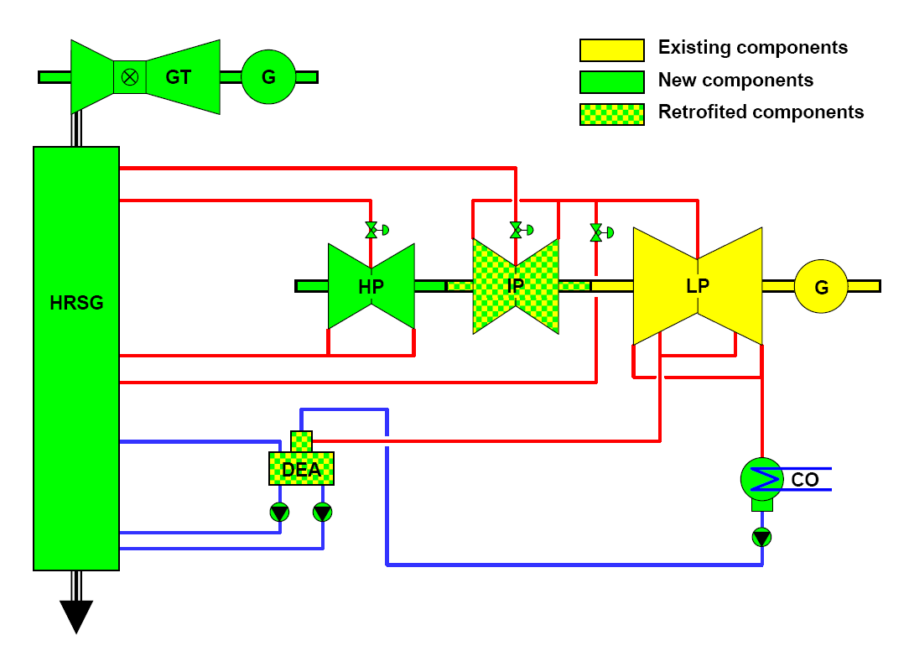
Triple Pressure Reheat Cycle (3PRH)
Typical 3PRH-Cycle
GT connected to HRSG
HRSG (3 pressure levels)
Steam turbine with
  New HP-turbine
  Retrofitted IP-Turbine
  LP-turbine as it is
  New HP-, RH- and LP-valves
Generator as it is
New Condenser
Modified Deaerator
New pumps
New piping

Slide 7
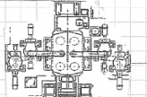
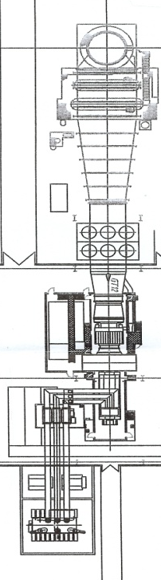
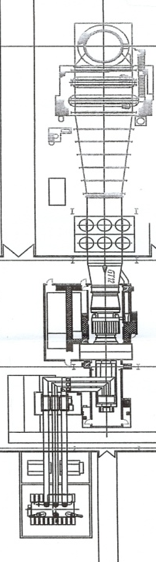
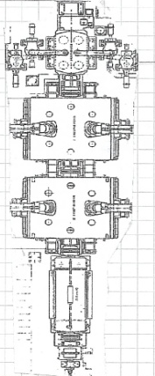
Arrangement (Phase 1)
~ 190 m
32 m
40 m
40 m
40m
38 m
22 m
22
HP
IP
LP1, 2
~145 m
1
2
3
4

Slide 8
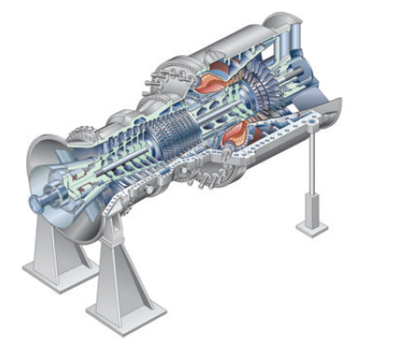
Major Equipment – Gas Turbine
Technical Data (ISO conditions) Only exempel
Type | F-class gasturbin
Gross power output | 257 | MW
Gross efficiency | 36.55 | %
Exhaust gas flow | 664 | kg/s
Exhaust gas temperature | 601.2 | °C
NOx @ 15 % O2 dry | 114 | kg/h
CO @ 15 % O2 dry | 27.8 | kg/h

Slide 9
Major Equipment – Heat recovery steam generator (HRSG)
Technical Data At 100 % gas turbine load, HRSG’s phase 1 with duct firing
Type | 3PRH (drum type, interstage attemperator)
Manufacturer | open
Pressure drop (gas side) | < 35 |  |  | mbar
Phase | Phase 1 |  | Phase 2 *)
Duct firing | installed |  | not installed
Max duct firing temperature | off | 800 | off | °C
HP-steam pressure | 98.0 | 177 | 160.5 | bar
HP-, hot reheat steam temperature | 565 / 565 | 565 / 565 | 565 / 565 | °C
*) new turbine blading required

Slide 10

Major Equipment – Steam Turbine Generator
New
HP-Turbine
IP-Turbine
outer casing of existing HP
new inner casing + rotor
Existing LP1 and LP2
No changes required
Existing Generator
No changes required
All stop- and control valves new due to much higher steam temperatures

Slide 11
Major Equipment – Steam Turbine Generator
Steam turbine generator limitations
The maximal power output of the plant is limited by:
LP-Turbine: maximal exhaust steam flow = 1140 kg/s
LP-Turbine: maximal exhaust wetness < as OEM-design (10.3 %)
No limitation expected up to 8 GT‘s installed due to:
Exhaust steam flow
Wetness of exhaust steam

Slide 12
Major Equipment – Steam Turbine Generator
Steam turbine generator limitations
The maximal power output of the plant is limited by:
Maximal generator load = 1635 MVA * 0.8 = 1308 MW (PF = 0.8)
Maximal Transformer load = 3 * 400 MVA * 0.8 = 960 MW (PF = 0.8)
Operating conditions
Steam turbine generator
Generator Limit (PF = 0.92):
Maximal 8 F-class gasturbin
P net = 1104 MW
P gross = 1142 MW

Slide 13
Major Equipment – Condenser, Deaerator
New condenser required (existing condenser could not be removed)
After final site desision: Cold end optimisation recommended!
Preliminary design:
  Cooling water temperature = 25 °C
  Cooling water temperature rise < 7.1 K (10 GT‘s installed)
  Cooling water flow = 77 m3/s
  Coolingsystem direct or tower still not clear
Required modification of existing deaerator :
Combined cycle requires low feed water temperature (60 °C) at HRSG inlet ➔ vacuum deaeration.
Change from over-pressure deaearation to vacuum-deaeration requires investigation by specialist.

Slide 14
Major Equipment – Pumps and piping
New (major) Pumps required:
HP-feed water pumps
IP-feed water pumps
Main condensate extraction pumps
Main cooling water pumps
Complete new Piping required (water, steam)
Different arrangement
Higher pressures
Higher temperatures

Slide 15
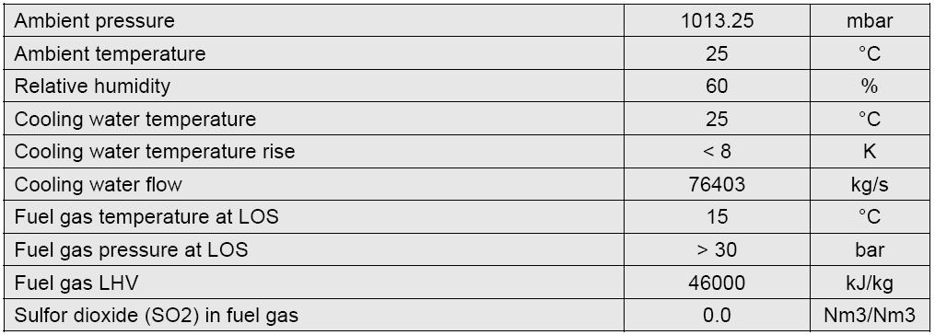
Site Conditions

Slide 16
Plant Performane – Assumptions and Conditions
All performance data presented are:
Based on site conditions
Based on proposed cycle configuration
Based on gas turbine performance from exempel GE 9FA, ISO conditions
Assumed gas turbine inlet and exhaust pressure loss
Estimated HP- and IP-turbine efficiency, LP-efficiecy based on OEM-heat balance
Assumed HRSG performance (pinch points)
Assumed plant auxiliary consumption
Expected values

Slide 17
Gas Turbine Performance corrected to ISO Conditions
Gas turbine F-class gasturbine
Ambient conditions see Paragraph 2
GT-inlet pressure drop 10 mbar only exempel
GT-outlet pressure drop 35 mbar only exempel
Fuel gas temperature at GT combustor inlet 150 °C only exempel
GT-power output at generator terminals 257 MW only exempel
GT-efficiency 36.55 % only exempel
GT-exhaust gas flow 664 kg/s only exempel
GT-exhaust gas temperature 601.2 °C only exempel
The GT-Brand is not now determined.
Investigations, negotiations in process.

Slide 18
Plant Performance Phase 1 (ISO conditions)
Maximal 4 gas turbines installed
HP- and IP-blading of steam turbine with reduced swallowing capacity:
  To achive maximal plant efficiency already in Phase 1
  To keep steam velocity in superheater- and reheater piping in acceptable range
HRSG‘s of Phase 1 equiped with duct burners – cheapes solution vor peaking power (if required). Maximal duct firing temperature = 800 C
Number of gas turbines in service 4
Duct firing (800°C) yes (800°C9
HP and reheat steam temperature 565°C
HP-steam pressure 177 bar
Hot reheat steam pressure 19.4 bar
Steam turbine output 852 MW
Plant net power output 1881.6 MW
Plant net efficiency 53.8 %

Slide 19
Plant Performance Phase 2 (ISO conditions)
Maximal 8 gas turbines installed
HP- and IP-blading of steam turbine with increased swallowing capacity:
  To achive maximal plant efficiency also in Phase 2
  To keep maximal HP-steam and reheat steam pressure in acceptable range
HRSG‘s of Phase 2 not equiped with duct burners
With 8 GT‘s installed ductburners of HRSG 1 to 4 can not be in service

Slide 20
Summary
Phase 1 with 4 F-class gasturbin installed
In Phase 1 non of the existing equipment (steam turbine generator and transformer) are overloaded
Performance without duct firing
  Net plant output up to 1587 MW
  Net plant efficiency up to 56.8 %
Performance with maximal duct firing
  Net plant output up to 1844 MW (peaking power)
  Net plant efficiency reduced to 53.8 %

Slide 21
Summary
Phase 2 (up to 8 F-class gasturbin installed)
The existing equipment limits the size of the power plant in Phase 2
Transformer limit (1104 MW / PF=0.92)
Maximal 8 F-class gasturbincan be installed to prevent overloading of step up transformer
  Net plant output = 3160 MW
  Net plant efficiency > 57 % over wide operation range
Generator limit (1635 MVA / PF=0.824)
Maximal 8 F-class gasturbin can be installed to prevent overloading of steam turbine generator (requires new step up transformer)
  Net plant output = 3952 MW
  Net plant efficiency > 57 % over wide operation range

Slide 22
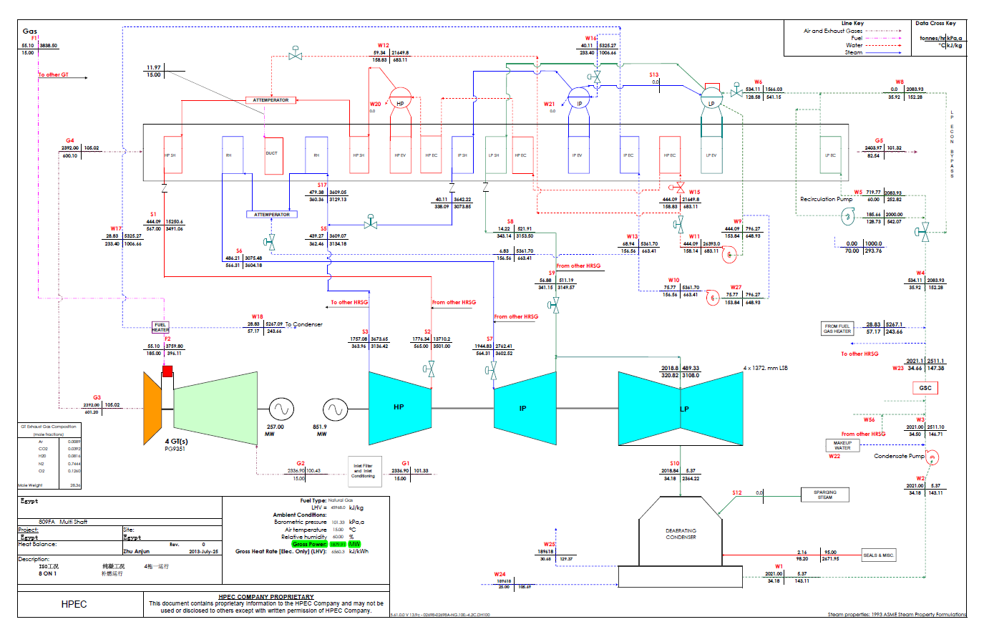
Heatbalance Phase 1

Slide 23
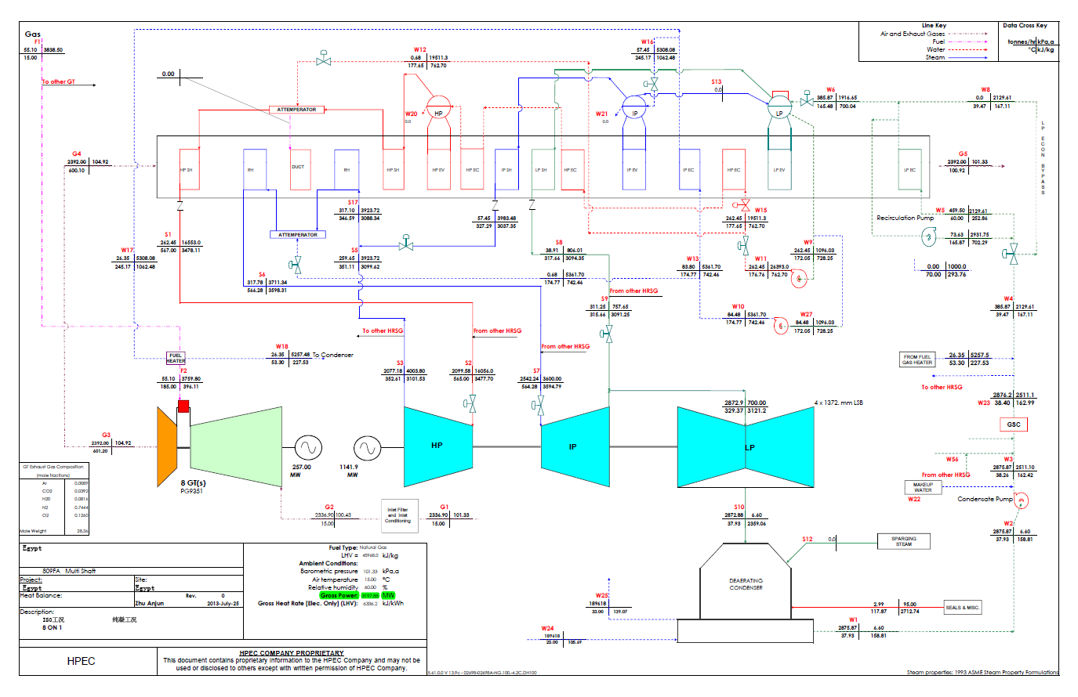
Heatbalance Phase 2

