Slide 1
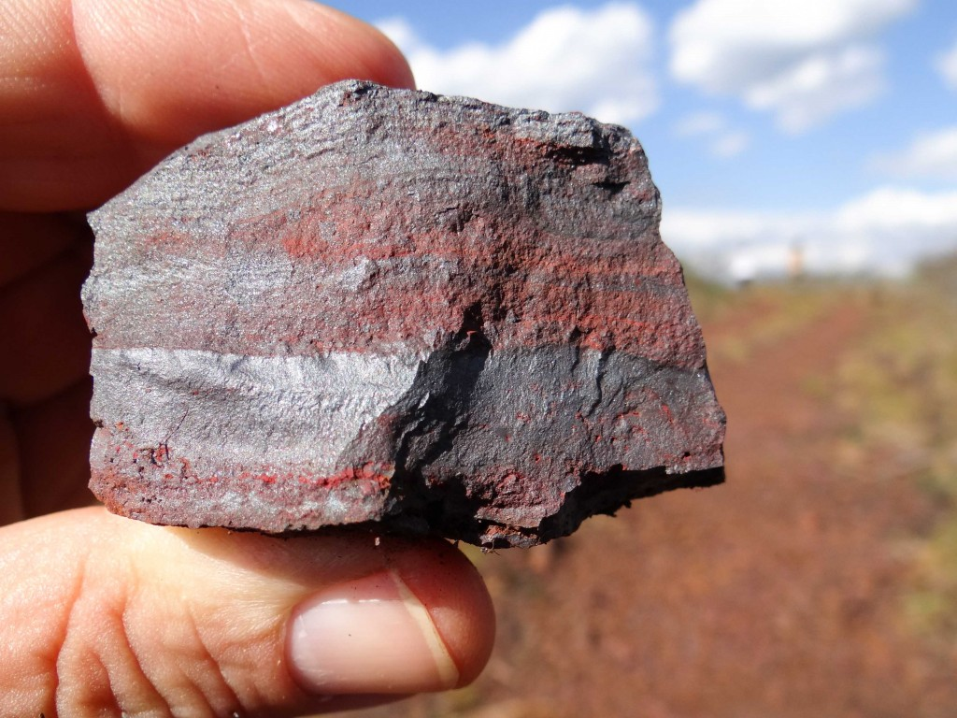
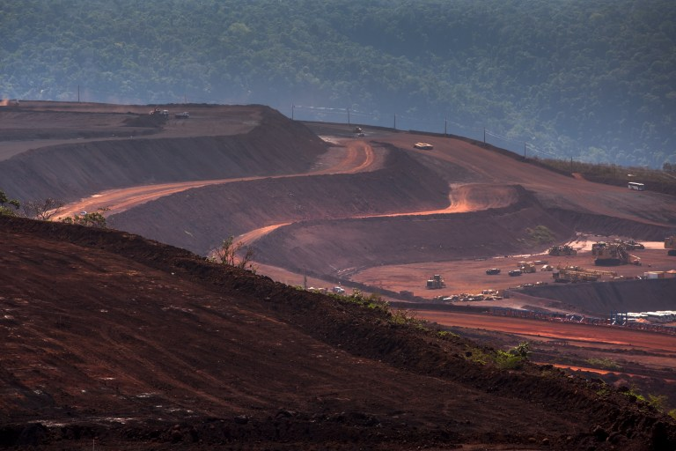
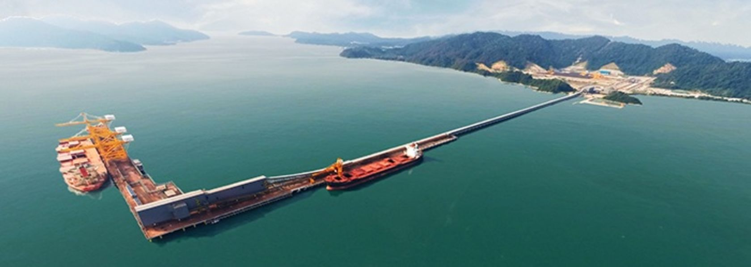
Sideral do Brasil Mineração
The largest iron ore mine in Tocantins/Br

Slide 2
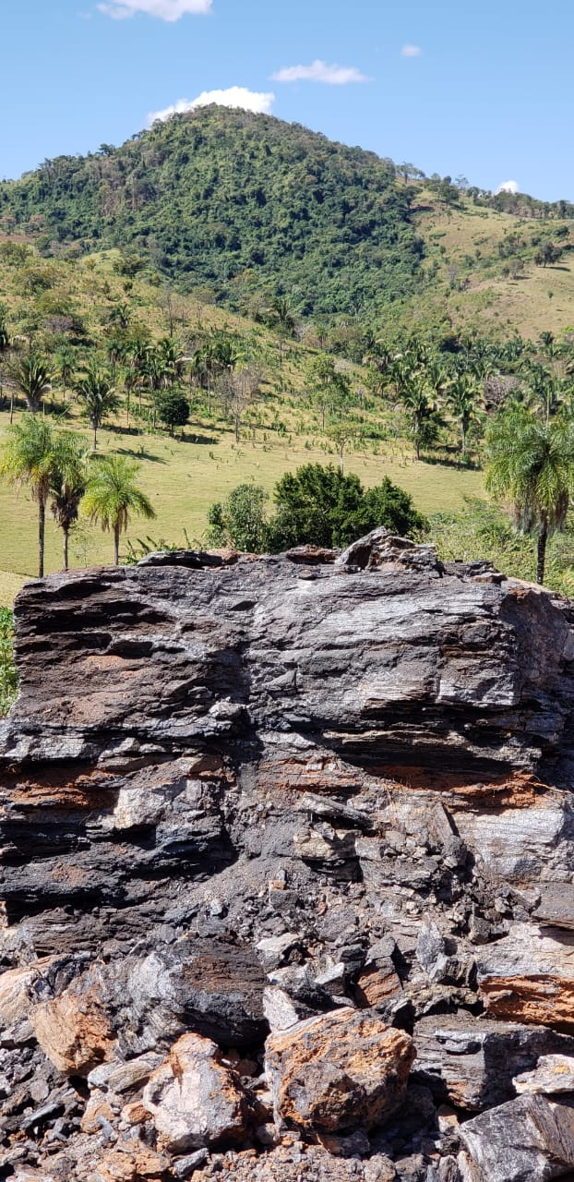
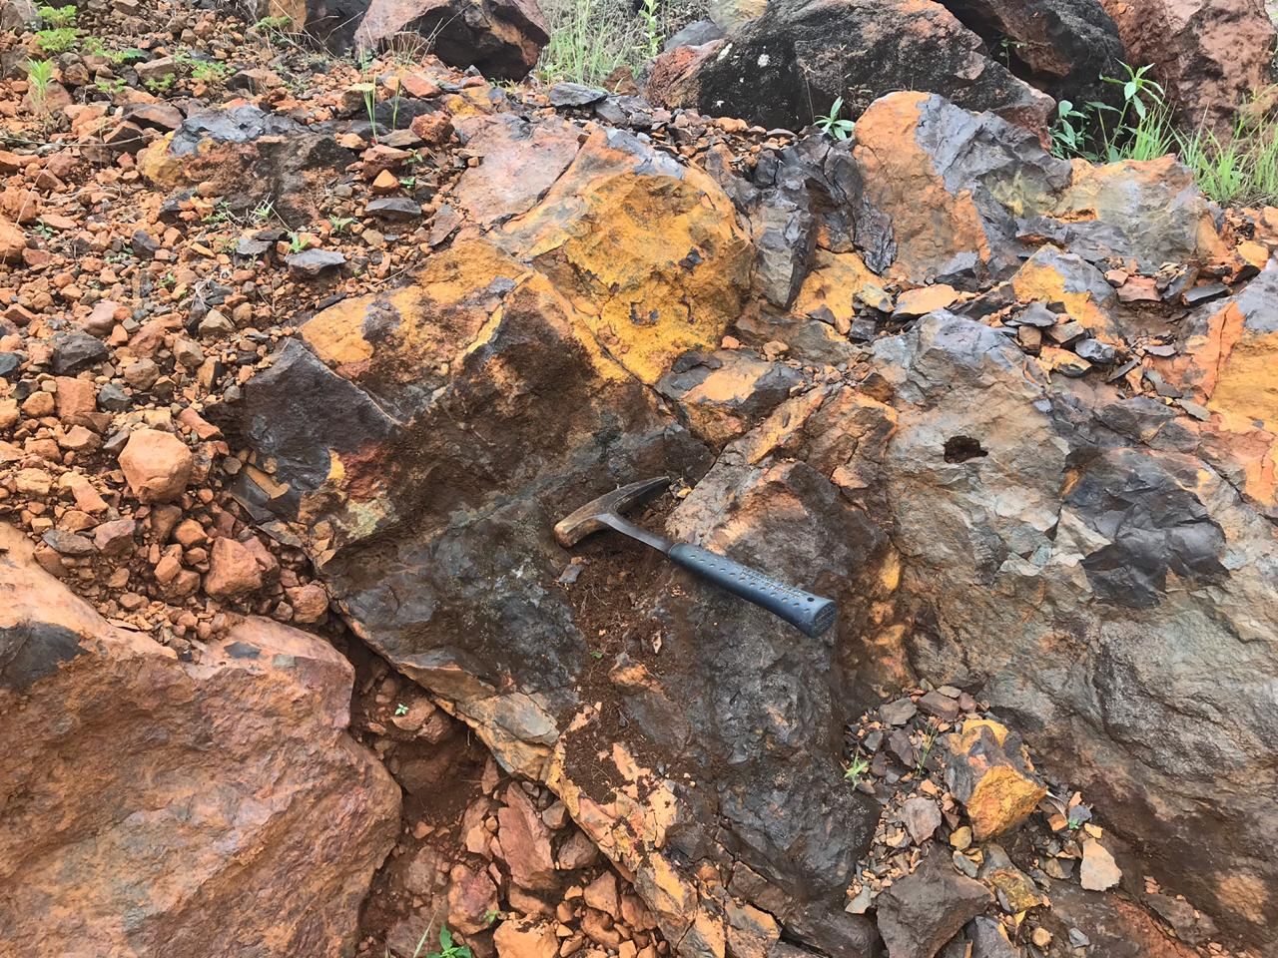
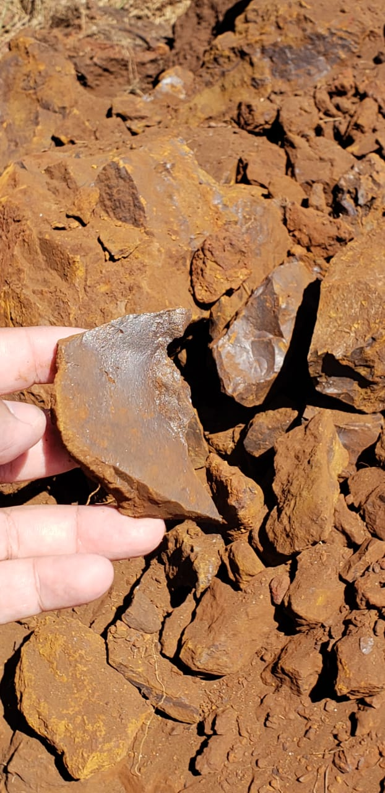
  The next major iron ore producer pole in Brazil
Supplier has the largest Iron Ore Mine in the State of Tocantins. It also has Manganese ore and Gold;
The Iron Ore mine has all concessions, active requirements with ANM(National Mining Agency), former DNPM, Exploration License, Environmental License and Operational License;
The MFe mine area is 40,000ha with active requirements and is located 30km from the North-South Railway;
The Mine has the potential to be one of the best Fe mines in the world due to its high Fe content, Low extraction cost (Rich and shallow ore), Granulometry, Optimal Logistic Flow and Estimated Large Volume;
Currently the ore exploited is at 63%Fe however, mean analysis targets of 66%Fe with very low contaminant levels have already been found, showing the potential to be one of the best ores in the world.

Slide 3
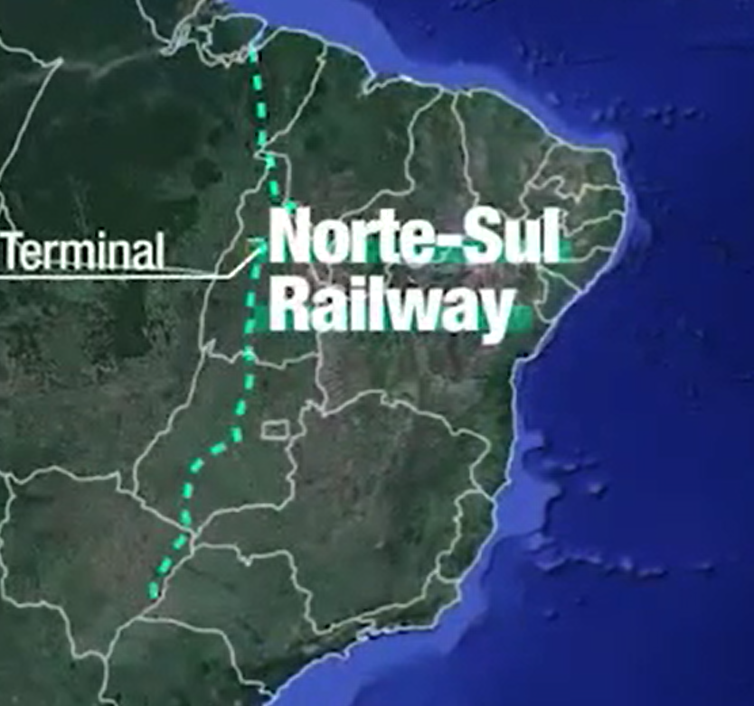
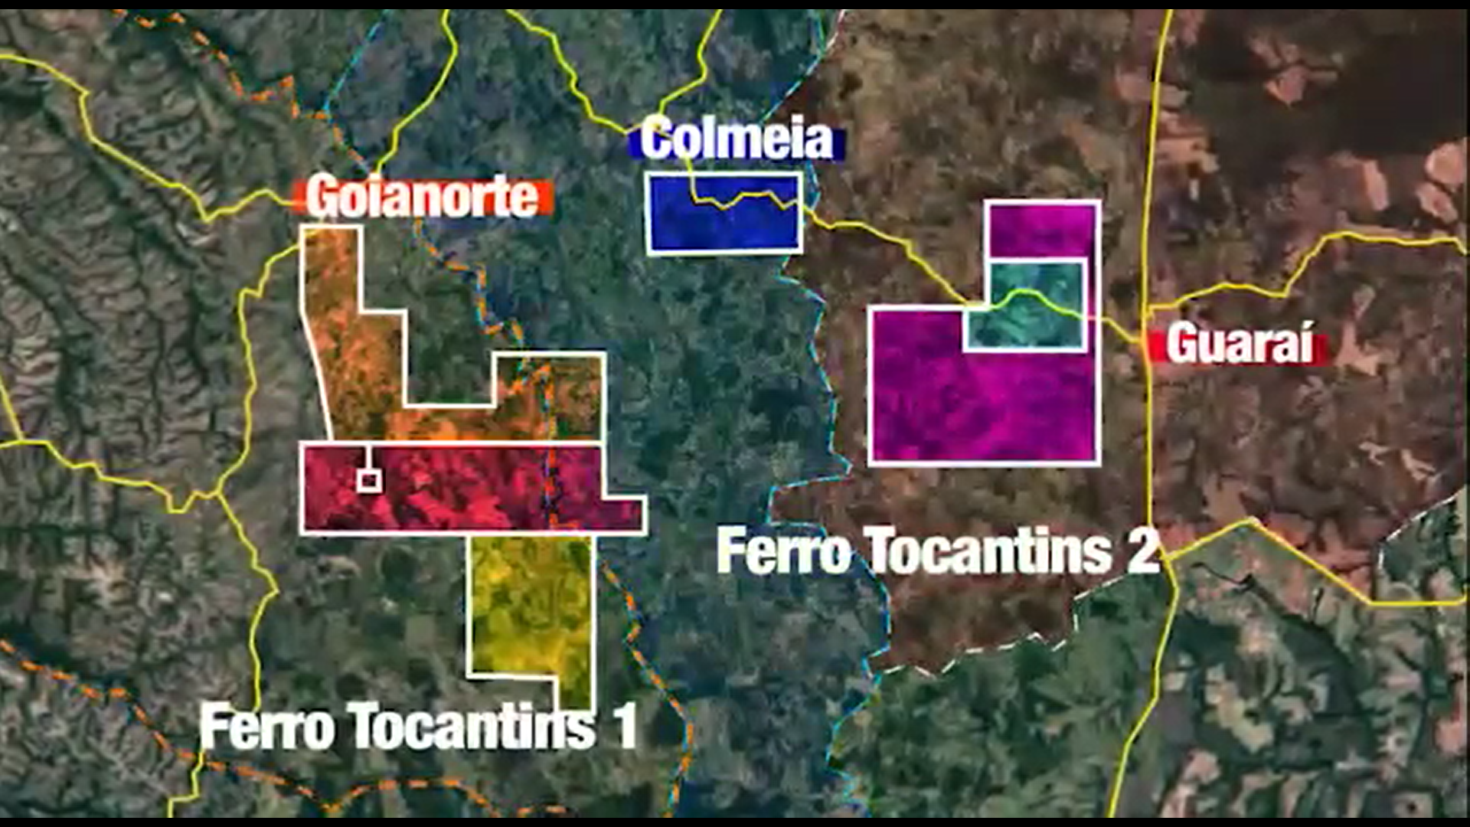
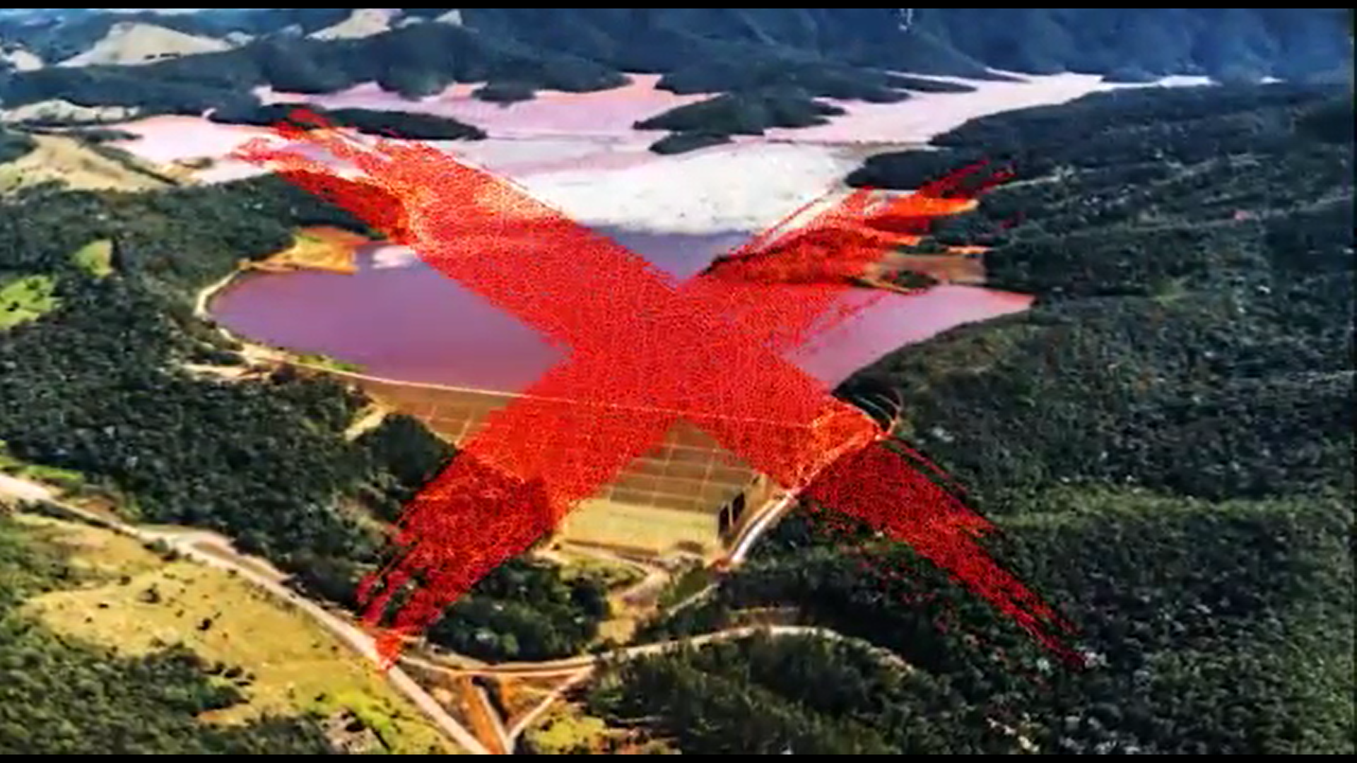
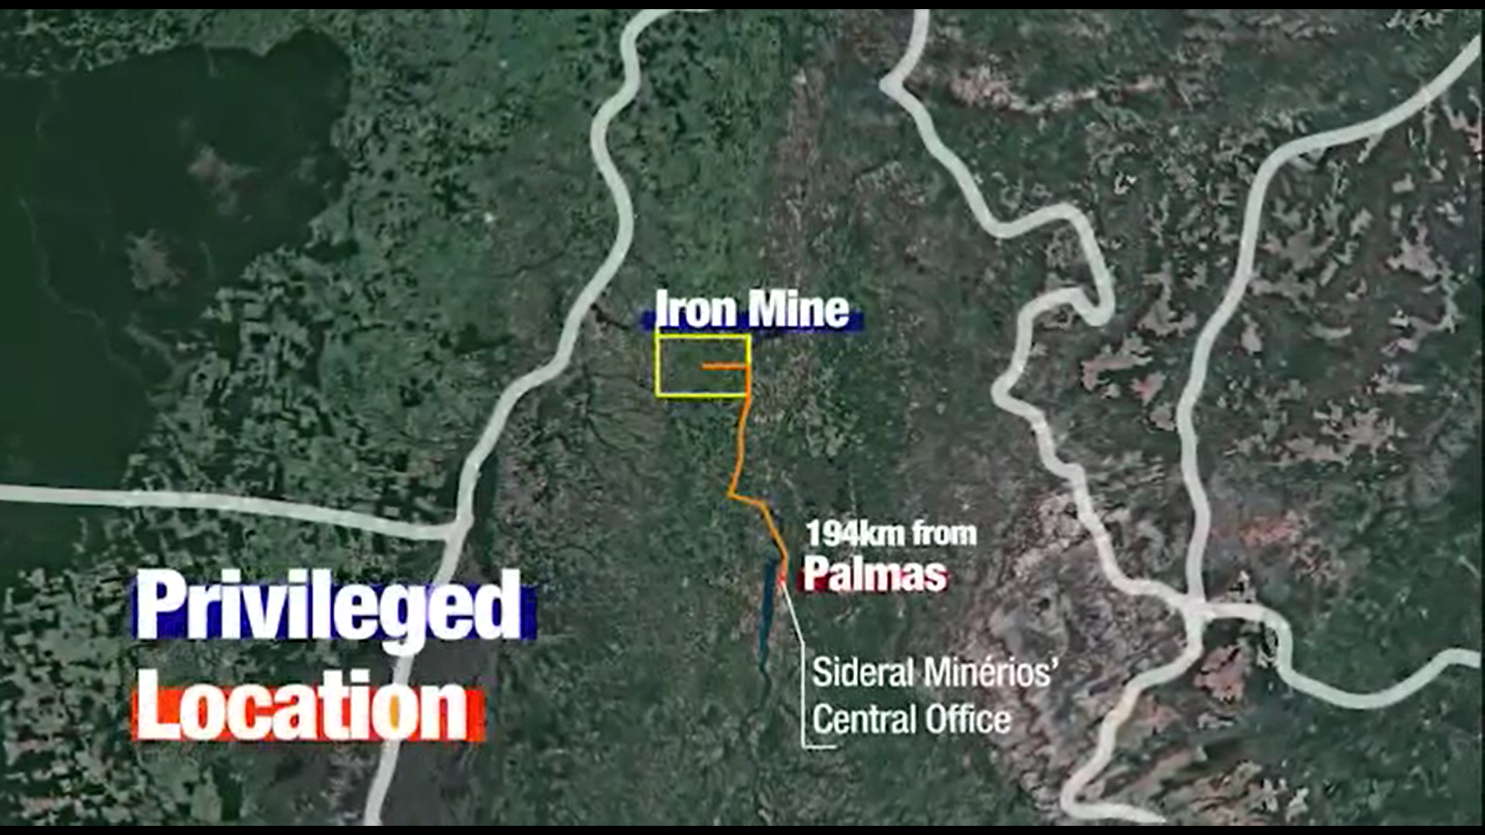
  On the side of the Railway and 100% dry mining

Slide 4
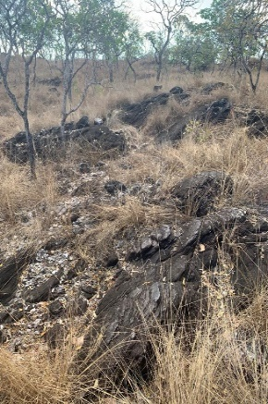
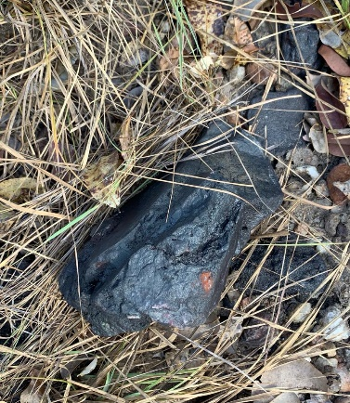
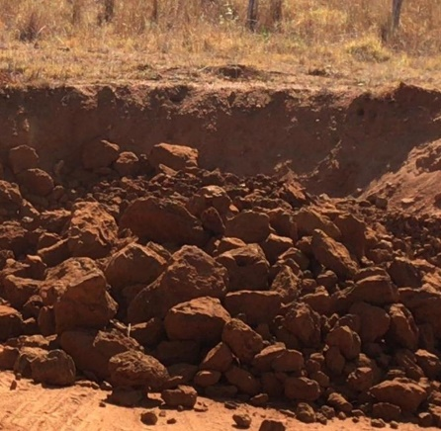
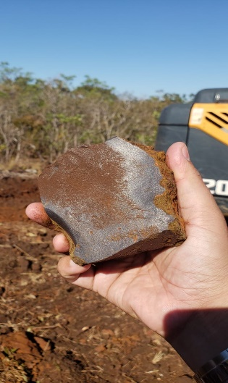
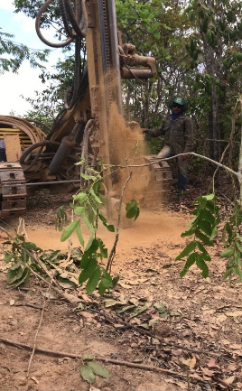
Targets identified - 56%Fe to 66%Fe
BRASIL ORE – TARGETS RESEARCH
Average Analysis |  |  | 1,99 | 1,86 | 61,29 | 0,04 | 0,39 | 0,01 | 6,46
Alvo | IDENTIFICATION | DATA | %SiO2 | %Al2O3 | %Fe | %Mn | %P | %S | %PPC
1 | ID01 - Em Pesquisa | 04/ago/20 | 3,55 | 3,81 | 56,67 | 0,04 | 0,668 | 0,006 | 10,72
2 | ID02 - Stand by | 04/ago/20 | 2,84 | 2,34 | 59,19 | 0,05 | 0,314 | 0,007 | 9,59
3 | ID03 - Stand by | 04/ago/20 | 0,57 | 1,86 | 60,37 | 0,08 | 0,837 | 0,018 | 9,30
4 | ID04 - Em Pesquisa | 04/ago/20 | 2,35 | 0,81 | 64,33 | 0,01 | 0,088 | 0,007 | 1,80
5 | ID05 - Em pesquisa | 04/ago/20 | 0,66 | 0,49 | 65,91 | 0,03 | 0,066 | 0,021 | 0,89
6 | ID06 - Stand by | 09/set/20 | 8,33 | 3,37 | 53,61 | 0,16 | 0,298 | 0,007 | 8,49
7 | ID07 - Stand by | 09/set/20 | 28,32 | 1,51 | 41,13 | 0,01 | 0,073 | 0,001 | 9,17
8 | ID08 - Aguardando ID 04 e 05 | 09/set/20 | 4,09 | 3,21 | 58,61 | 0,04 | 0,177 | 0,000 | 8,19
9 | ID09 - Aguardando ID 04 e 05 | 09/set/20 | 5,49 | 1,41 | 56,97 | 0,04 | 0,211 | 0,000 | 7,86
10 | ID10 - Aguardando ID 04 e 05 | 09/set/20 | 2,06 | 1,72 | 62,36 | 0,07 | 0,235 | 0,001 | 6,51
02 km from Shallow Iron floor
68%Fe Aflorado ore
Trenches - 58% to 63%Fe
67%Fe Hematite
Rock drill hole

Slide 5
Target Development 10
From Research to Extraction - Evolution in Quality
SIDERAL BRASIL ORE – TARGETS RESEARCH
Average Analysis |  |  | 1,99 | 1,86 | 61,29 | 0,04 | 0,39 | 0,01 | 6,46
Alvo | IDENTIFICATION | DATA | %SiO2 | %Al2O3 | %Fe | %Mn | %P | %S | %PPC
10 | ID10 - Aguardando ID 04 e 05 | 09/set/20 | 2,06 | 1,72 | 62,36 | 0,07 | 0,235 | 0,001 | 6,51
Sampling performed in 553ton of material - Average analysis of Homogenized Loads
SGS Standard Analysis Report - Sampling over 500ton on Target 10 only
 | Descrição | SiO2 | Al2O3 | Fe | Mn | P | S
1 | CM 01 | 3,42 | 1,661 | 61,44 | 0,12 | 0,249 | 0,010
2 | CM 02 | 1,96 | 1,987 | 64,15 | 0,10 | 0,273 | 0,005
3 | CM 03 | 2,01 | 1,797 | 65,01 | 0,10 | 0,275 | 0,011
4 | CM 04 | 2,66 | 1,523 | 62,20 | 0,09 | 0,1,91 | 0,009
5 | CM 05 | 2,17 | 1,449 | 63,77 | 0,07 | 0,196 | 0,018
6 | CM 06 | 1,94 | 1,631 | 64,89 | 0,08 | 0,214 | 0,021
7 | CM 07 | 2,00 | 1,622 | 64,85 | 0,16 | 0,230 | 0,016
8 | CM 08 | 1,95 | 1,910 | 63,03 | 0,21 | 0,242 | 0,009
9 | CM 09 | 1,85 | 1,803 | 64,85 | 0,09 | 0,221 | 0,012
10 | CM 10 | 1,65 | 1,633 | 64,75 | 0,08 | 0,235 | 0,005
 | MEDIA | 2,16 | 1,702 | 63,89 | 0,110 | 0,237 | 0,012

Slide 6
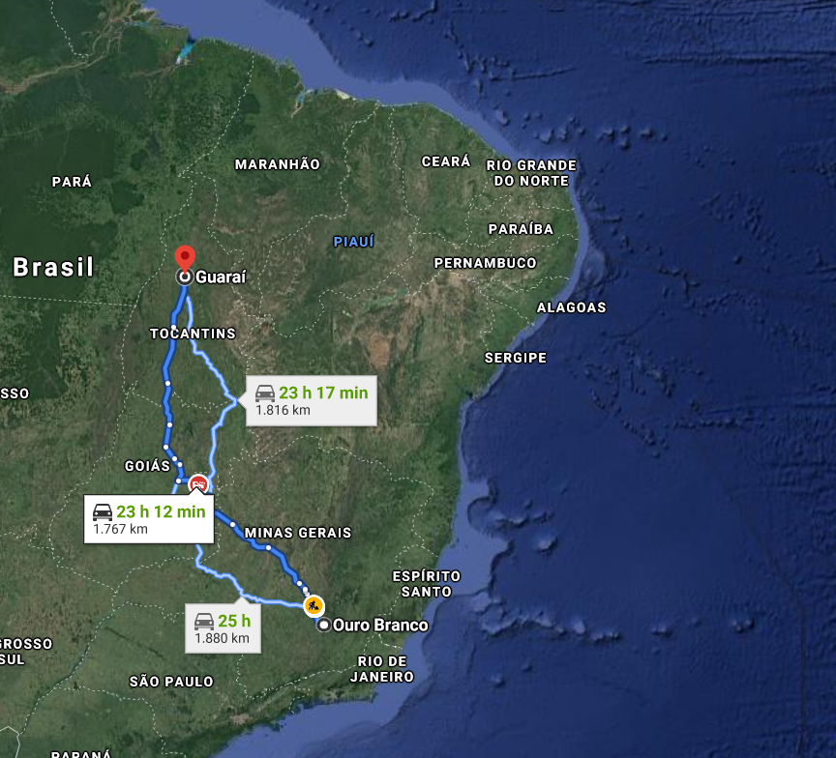
  High Fe content, Rail and Road runoff
Porto de Itaqui
Para Exportação o Ideal é escoamento para o Porto de Itaqui via ferrovia Norte-Sul;
Para Mina Gerais usaremos Frete de retorno para garantir preços competitivos

Slide 7
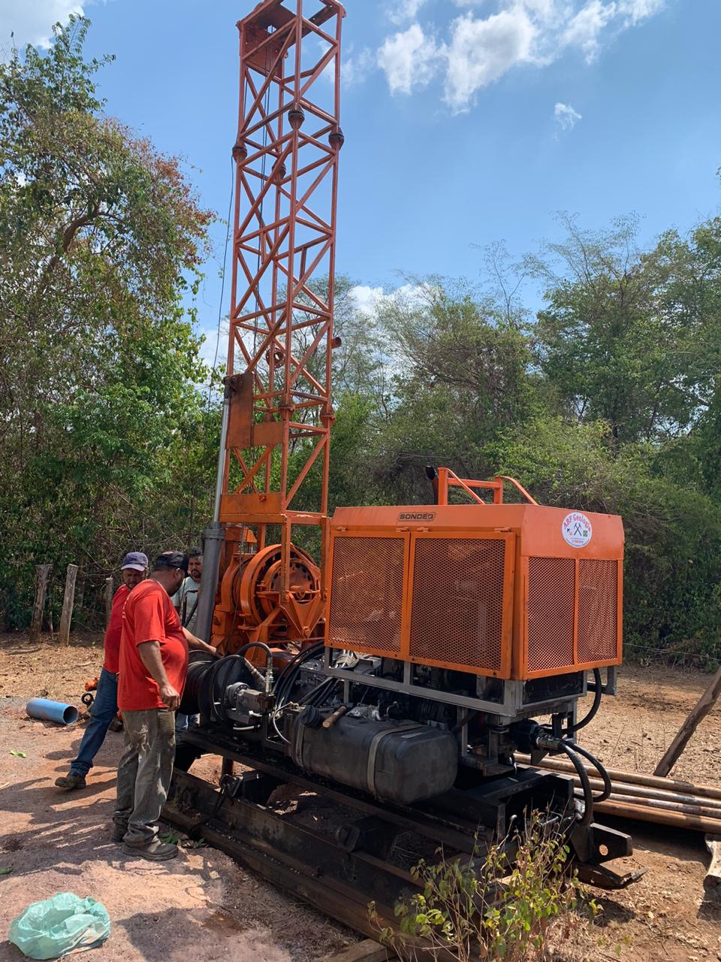
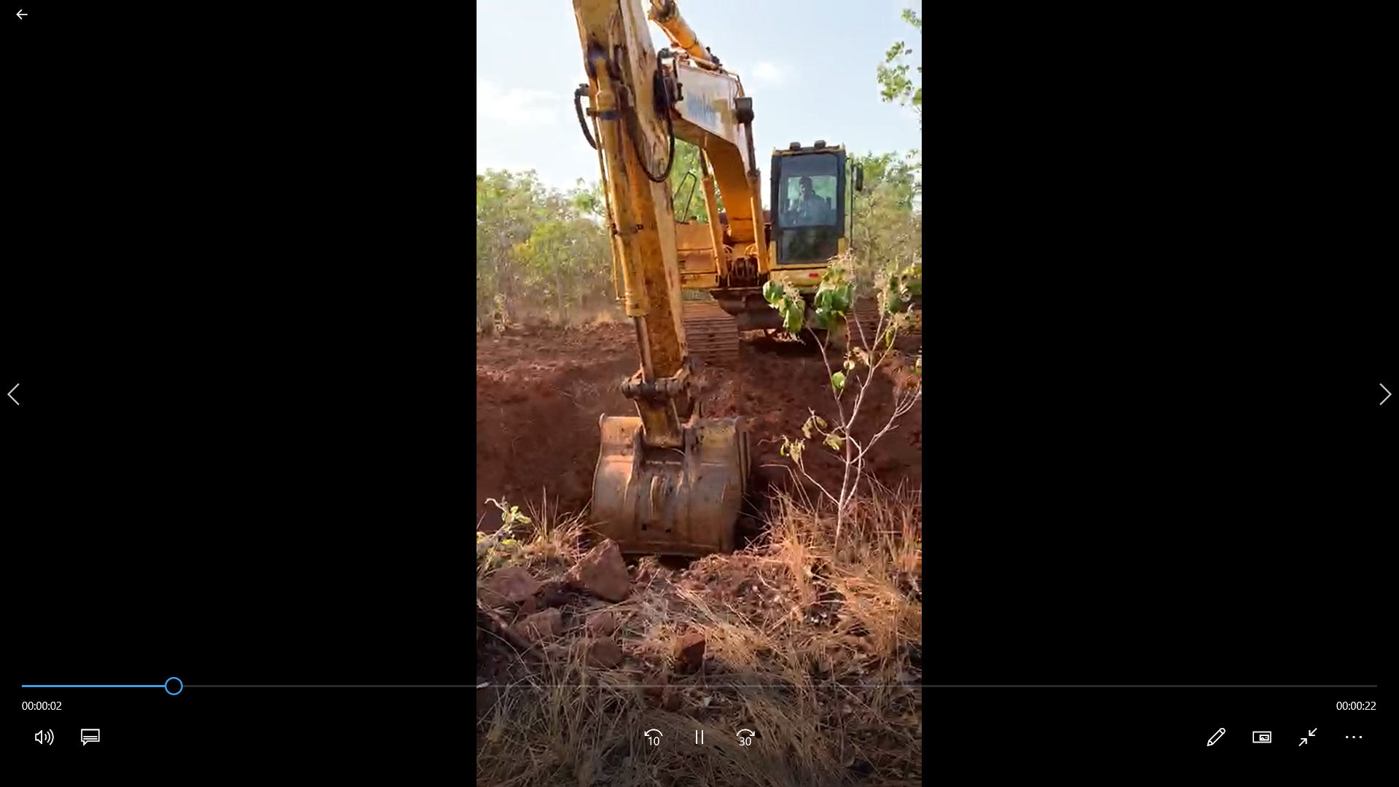
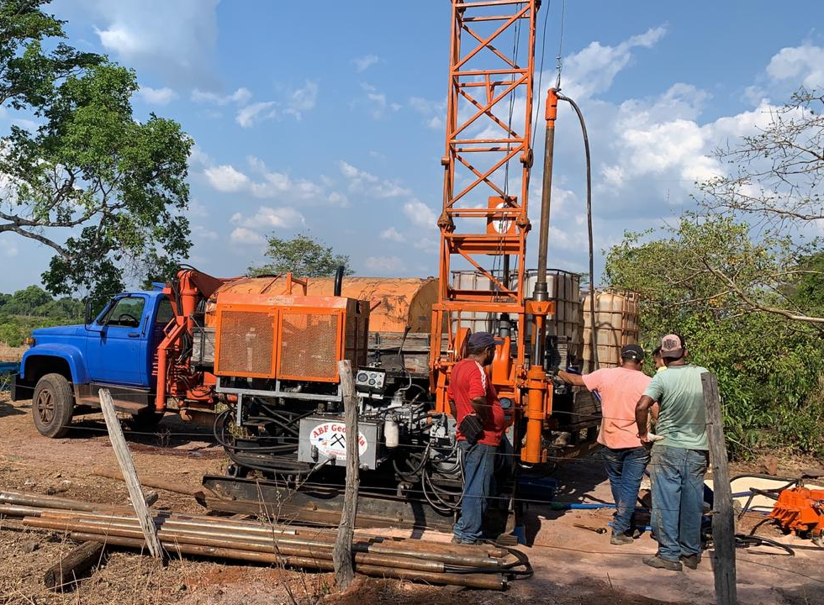
  Done Partial Research and Starting Polls

